Slide 1
Kitsap County Comprehensive Plan Update

Slide 2
Overview of Presentation
What is a Comprehensive Plan?
History, Requirements, Timelines
2016 Comprehensive Plan Schedule
Major Tasks Overview/Update
Policy Document Changes and Overview
Preliminary Draft Land Use
Next Steps

Slide 3
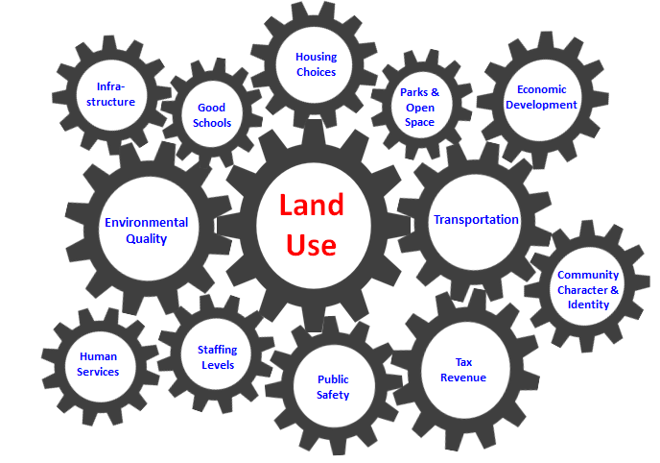
What is a Comprehensive Plan?
A comprehensive plan is “a generalized coordinated land use policy statement of the governing body of a county or city . . .”
Source: Joe Tovar

Slide 4
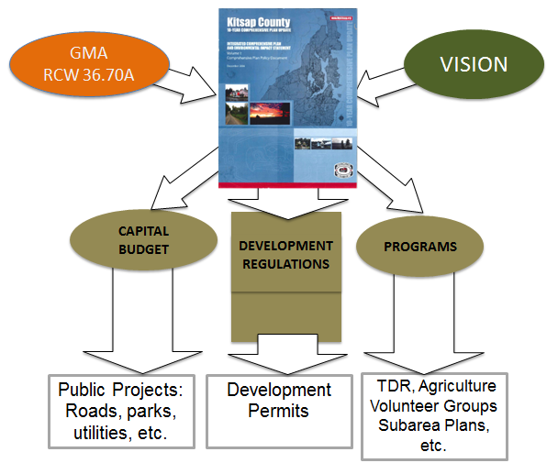
How is the Comprehensive Plan Implemented?

Slide 5
Kitsap County Comprehensive Plan History
In Progress
1998
2016
2006

Slide 6
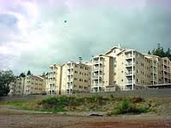
What is the Driving Force?
Address Population Growth, Housing, Jobs and Service Demand
For every 3 people in Kitsap County now, there will be 1 more by 2036

Slide 7
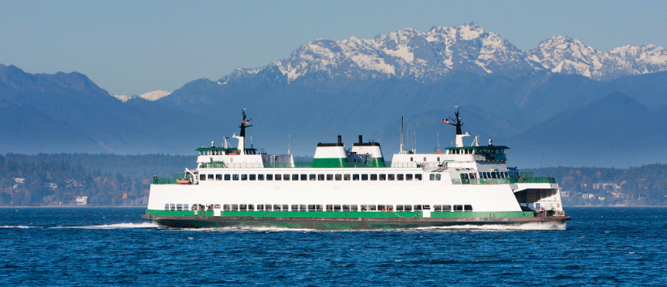
What Does the Growth Management Act Say?
Kitsap County is required to review its Comprehensive Plan and review and revise IF NECESSARY, by June 2016.
Required Elements:
Land Use
Housing
Capital Facilities
Utilities
Transportation
Rural
Economic Development
Optional Elements:
Historic Preservation
Parks and Recreation
Environment

Slide 8
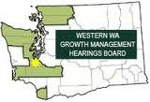
What Must the County Consider in the Update?
Changes made by the State Legislature
Updates in Population and Other Data
PSRC’s Vision 2040 Policies
Countywide Planning Policies
Relevant Court Cases

Slide 9
Let’s Hear Kitsap Public Participation Plan for the Comprehensive Plan Update
Transportation
Environment
Economic Development
Parks
http://compplan.kitsapgov.com/Pages/home.aspx

Slide 10
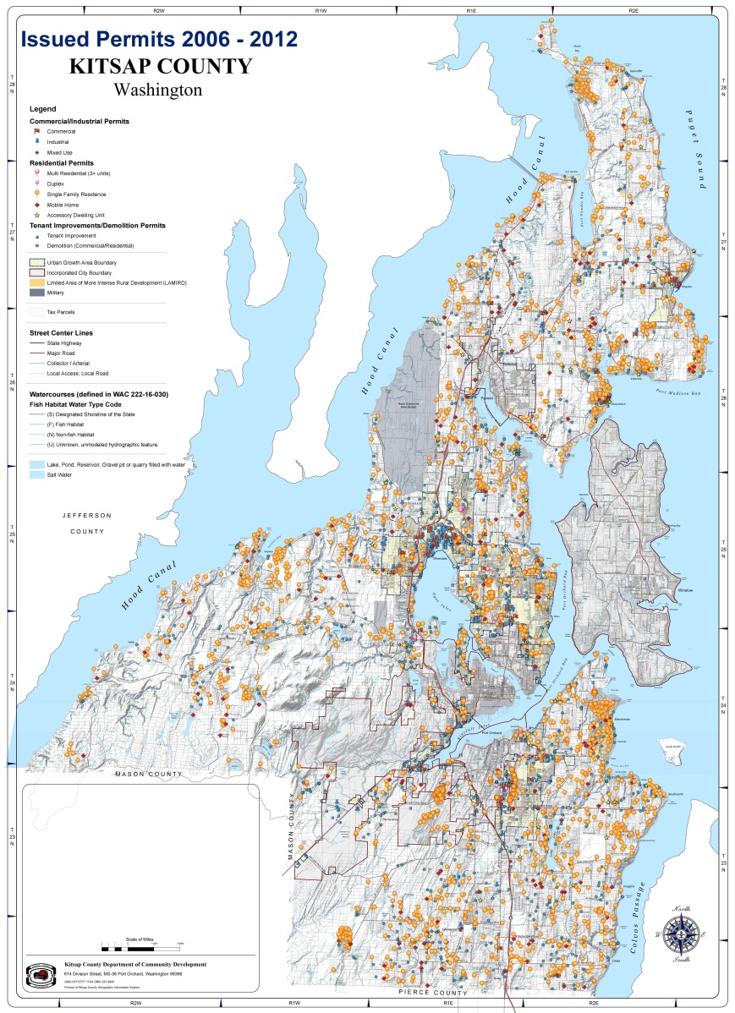
Buildable Lands Report
Submitted to the WA State Dept of Commerce on June 30, 2015

Slide 11
Comprehensive Plan Policy Document: Goals, Policies and Strategies (GPS)
GOAL: most commonly known as an aspiration or vision. It’s a broad idea of WHAT you want.
POLICY: This is HOW we think we can achieve the goals. The policy is an approach to the goal that we can measure and evaluate to track progress or see where we need to reevaluate the way in which we try to accomplish the goal.
STRATEGY: The strategy translates our thoughts into ACTION. It identifies and coordinates the people, resources, money and time frame of completing a policy and incorporates measurements for future evaluation.

Slide 12
Internal Review Team (IRT)
“A strong, interdisciplinary team will be required to review and revise the existing Comprehensive Plan. As the Plan touches almost all aspects of County operations, the team will draw from a large number of program disciplines.”
Dept. of Community Development
Commissioner’s Office
Kitsap Public Health District
Public Works -Transportation
Public Works -Sewer Utility
Public Works -Clean Water Kitsap
Public Works -Solid Waste
Kitsap Transit
Human Services
Parks and Recreation
Housing
Kitsap Economic Development Alliance
Legal
Sheriff
Information Services
Fire Marshal
Kitsap Public Utilities District

Slide 13
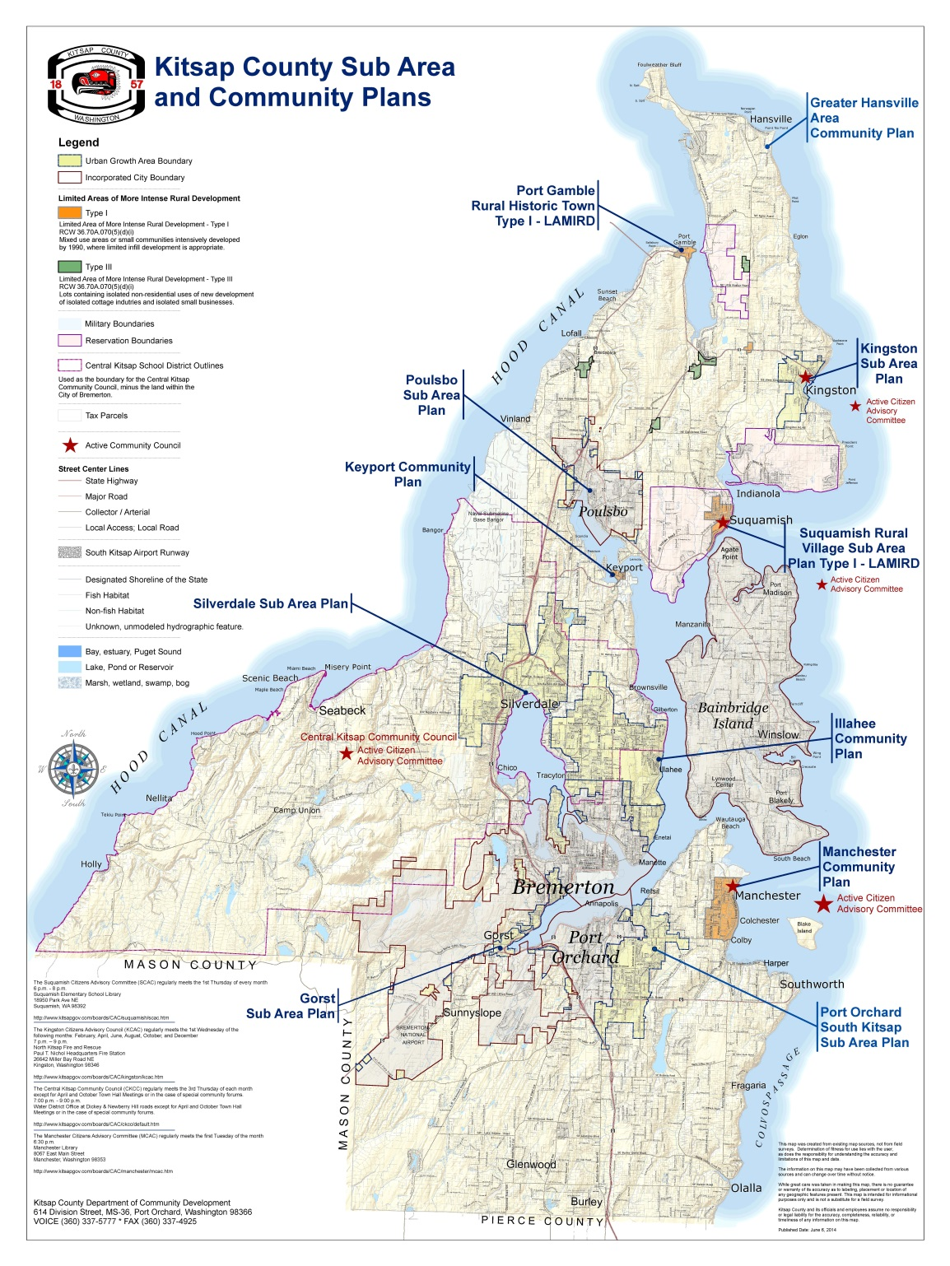
Sub-Area Plans
Updates
UGA Plans
Silverdale
Kingston
Gorst
Poulsbo
LAMIRD* Plans
Suquamish
Keyport
Manchester
Community Plan
Illahee
*Limited Area of More Intensive Rural Development

Slide 14
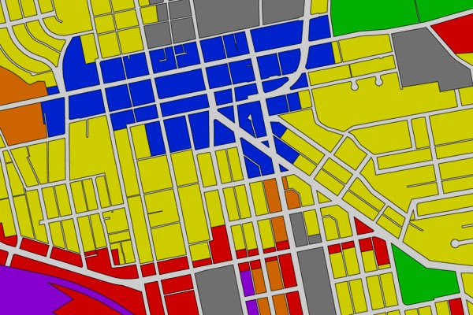
Land Use Alternatives
Alternative 1: No Action
Current Plan
Alternative 2: Whole Community
Reflects Guiding Principles and GMA Directives
Alternative 3: All Inclusive
Most Possible Changes; All Reclassification Requests.
Amendments in All Alternatives:
Tribal Property Corrections
Split-Zone Corrections
Parks Zone
Public Facility Zone
Urban Reserve Zone
Commercial Zones

Slide 15
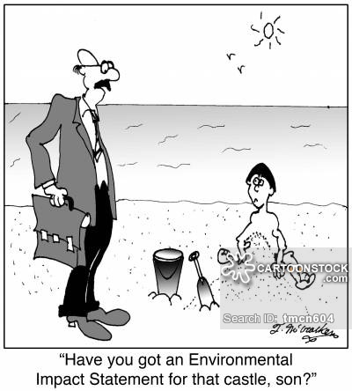
Supplemental Environmental Impact Statement (SEIS)
Purpose and Overview
Addressing Non-project & Area-Wide Amendments
Supplements 2006 EIS & 2012 SEIS
Provides Information on Proposal & Alternatives
Addresses a Range of Natural & Built Environment Topics

Slide 16
Capital Facilities Plan Update
GMA Required
Essential Components
Inventory
Levels of Service & Demand Analysis
Costs and Revenue
Address County and Non-County Facilities and Infrastructure
Support Urban Growth in UGAs

Slide 17
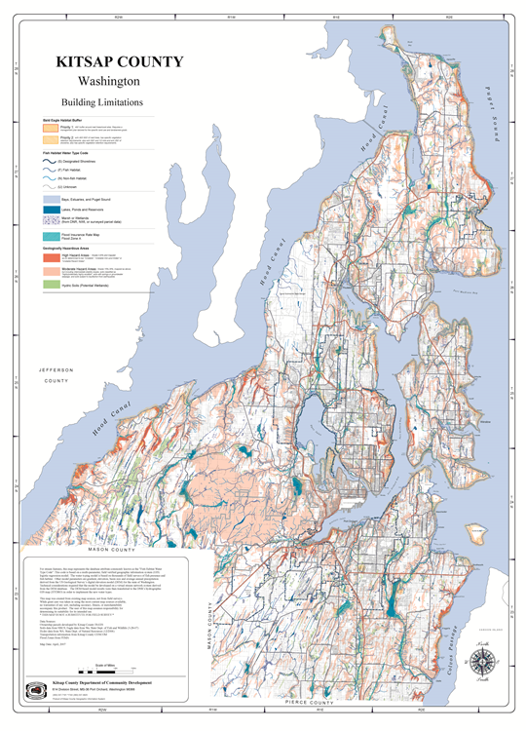
Critical Areas Ordinance Update
Review and Revise, as Necessary
Reviewing and Analyzing Best Available Science
Any Resulting Code Amendments Due By June 30, 2016

Slide 18
Next Steps
Open Houses to Review Draft Comprehensive Plan, SEIS, CFP, and Land Use Alternatives
November 10, 2015 - County Admin Building Chambers
5:00 to 7:00 pm
November 12, 2015 - Poulsbo City Chambers
5:00 to 7:00 pm
November 16, 2015 - Silverdale Beach Hotel
5:00 to 7:00 pm
Our website will also be featuring LIVE CHAT--- *Ask a Planner* Coming Soon!

Slide 19
QUESTIONS OR COMMENTS?
Katrina Knutson, Senior Planner, AICP
kknutson@co.kitsap.wa.us
http://compplan.kitsapgov.com/Pages/home.aspx

