Slide 1

Kitsap County Comprehensive Plan Periodic Review and Update
Board and Planning Commission Joint Work-Study
November 23, 2015

Slide 2
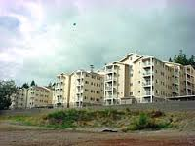
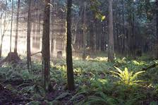
Agenda
Topic One: Schedule Refresher
Topic Two: Policy Document
Topic Three: Supplemental Environmental Impact Statement
  Land Use Alternatives
Topic Four: Capital Facilities Plan
Topic Five: Next Steps and Schedule

Slide 3
Comprehensive Plan Schedule Overview
Population and Employment Targetting
Buildable Lands Report
Scoping/Needs Assessment
Visioning
Document Drafting
Policy Document
SEIS
CFP
Preferred Alternative
Draft Final Documents
Legislative Process
Public Outreach

Slide 4

Policy Document
Periodic Update - Review and Revise
  Board Guiding Principles
  Internal Review Team – collaboration and outreach
  178 goals/558 policies (= 736 total – down from approximately 1300)
  7 key elements (formerly 11 – combined)
Plan Layout
  Readability and engagement
  Web presence, access and visuals http://compplan.kitsapgov.com

Slide 5

Policy Document-GPS
Kitsap County Mission
Overall Plan Vision
Executive Summary
Guiding Directives
GPS
  Goals
  Policies
  Strategies
    Guide Plan implementation
    On-going development

Slide 6

Policy Document-Key Elements
Land Use (17/70)
  General Land Use
  Rural Lands
  Resource Lands
Economic Development (9/46)
Environment (4/14)
Housing and Human Services (9/35)
Transportation (10/38)
Parks, Recreation and Open Space (4/25)
Capital Facilities and Utilities (14/42)
( ) represents total goals/policies

Slide 7
Policy Document-Subarea Plans
Updated
  Suquamish (12/23)
  Kingston (15/52)
  Manchester (15/25)
  Silverdale (16/44)
      Added: Silverdale Regional Growth Center (19/76)
  Illahee (11/17)
  Keyport (23/46)
Future shape of Community Plans – work-study topic

Slide 8
Policy Document - Appendices
Appendix A – GMA Amendments Matrix
Appendix B – Public Participation Plan, Let’s Hear Kitsap
Comprehensive Plan and Zoning Map Definitions

Slide 9

Supplemental Environmental Impact Statement (SEIS)
Prepared in accordance with the State Environmental Policy Act (SEPA)
Analyzes three Land Use Alternatives (2016-2036) and their impacts
Adopts the following prior Environmental Impact Statements by reference:
  Kitsap County 10-Year Comprehensive Plan Update-Integrated Plan and Environmental Impact Statement, Volume II: Final EIS, December 2006
  Kitsap County Urban Growth Area Sizing and Composition Remand, Final SEIS, August 10, 2012
  City of Bremerton and Kitsap County, Gorst Creek Watershed Characterization and Framework Plan, Gorst Subarea Plan, and Gorst Planned Action, October 8, 2013

Slide 10
SEIS: Major Issues, Significant Areas of Controversy and Uncertainty, and Issues to be Resolved
The key environmental issues and options facing decision makers are:
the location of growth;
sizing and composition of UGAs, given growth expected over the 2012-2036 period; and
the level of capital improvements needed to support land use and growth levels.
Prior to final plan adoption, the following issues are anticipated to be resolved:
refinement of a Preferred Alternative following public comment;
preparation of associated land use plan and development regulations;
selection and refinement of capital facility projects supporting land use, including transportation; and
refinement of goals, objectives, and policies as well as implementing regulations.

Slide 11
Contents of the SEIS
Front Matter:
  Determination of Significance
  Fact Sheet
  Distribution List
Chapter 1: Summary
Chapter 2: Alternatives
Chapter 3: Affected Environment, Significant Impacts, and Mitigation Measures
Chapter 4: Reclassification Requests
Acronyms, Abbreviations and References
  Appendices
  Appendix A: Base Year Population and Countywide Planning Policies
  Appendix B: Growth Estimates
  Appendix C: Zoning Maps
  Appendix D: Prior Alternatives 2006 and 2012
  Appendix E: Air Quality Tables
  Appendix F: Impervious Areas
  Appendix G: Reasonable Measures
  Appendix H: Transportation

Slide 12
SEIS: Land Use Alternatives
Alternative 1 No Action: current Comprehensive Plan as of September 2015.
Alternative 2 Whole Community: reflects Guiding Principles and GMA Directives.
Alternative 3 All Inclusive: most changes to the land use plan; all reclassification requests; reflects GMA requirements.

Slide 13
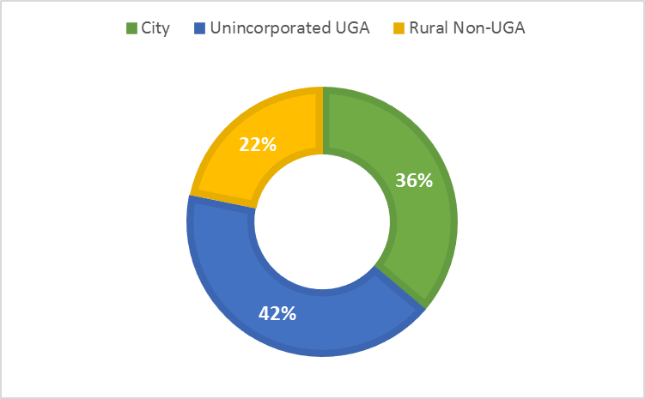
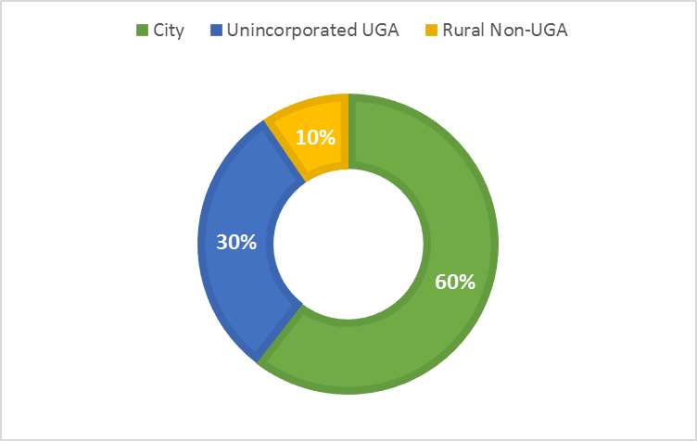
SEIS: Population and Employment Targets
Population Growth Target Shares (2012-2036)
Employment Growth Target Shares (2012-2036)

Slide 14
SEIS: Level of Analysis
This SEIS considers potential environmental impacts at both the countywide and smaller area levels of detail:
Countywide analysis. In general, environmental analysis has been conducted at a countywide and cumulative level. For example, air quality and transportation impacts are considered across the county.
Specific analysis. For some elements of the environment, information has been broken down into smaller areas of analysis. For example, watershed basins are referenced when possible in the discussion of surface water. Land use, population, housing, and employment are described by UGA.

Slide 15
SEIS: Land Use Plan and Zoning Consistency Changes
Tribal Property Corrections. The future land use plan and zoning maps would be corrected to reflect land in tribal ownership that is under tribal management and not under County jurisdiction.
Split-Zone Corrections. Single parcels of land with unintentionally two or more land use or zoning designations would be given a single designation.
Parks Zone. The County applies its Parks zone to public parks and recreation facilities. Not all parks were so designated and map corrections would apply the Parks zone to properties that qualify for the classification.
Public Facility Zone. A new Public Facility Zone would be created and applied to public facilities such as schools, fire stations, transit facilities, and others.
Urban Reserve Zone. The Urban Reserve land use designation and zoning would be removed and reclassified primarily to rural categories.
Commercial Zones. Commercial zones would be reduced in number, though still applied in similar locations as Alternative 1. Mixed-use residential and commercial would be allowed in more commercial zones with Alternatives 2 and 3.

Slide 16
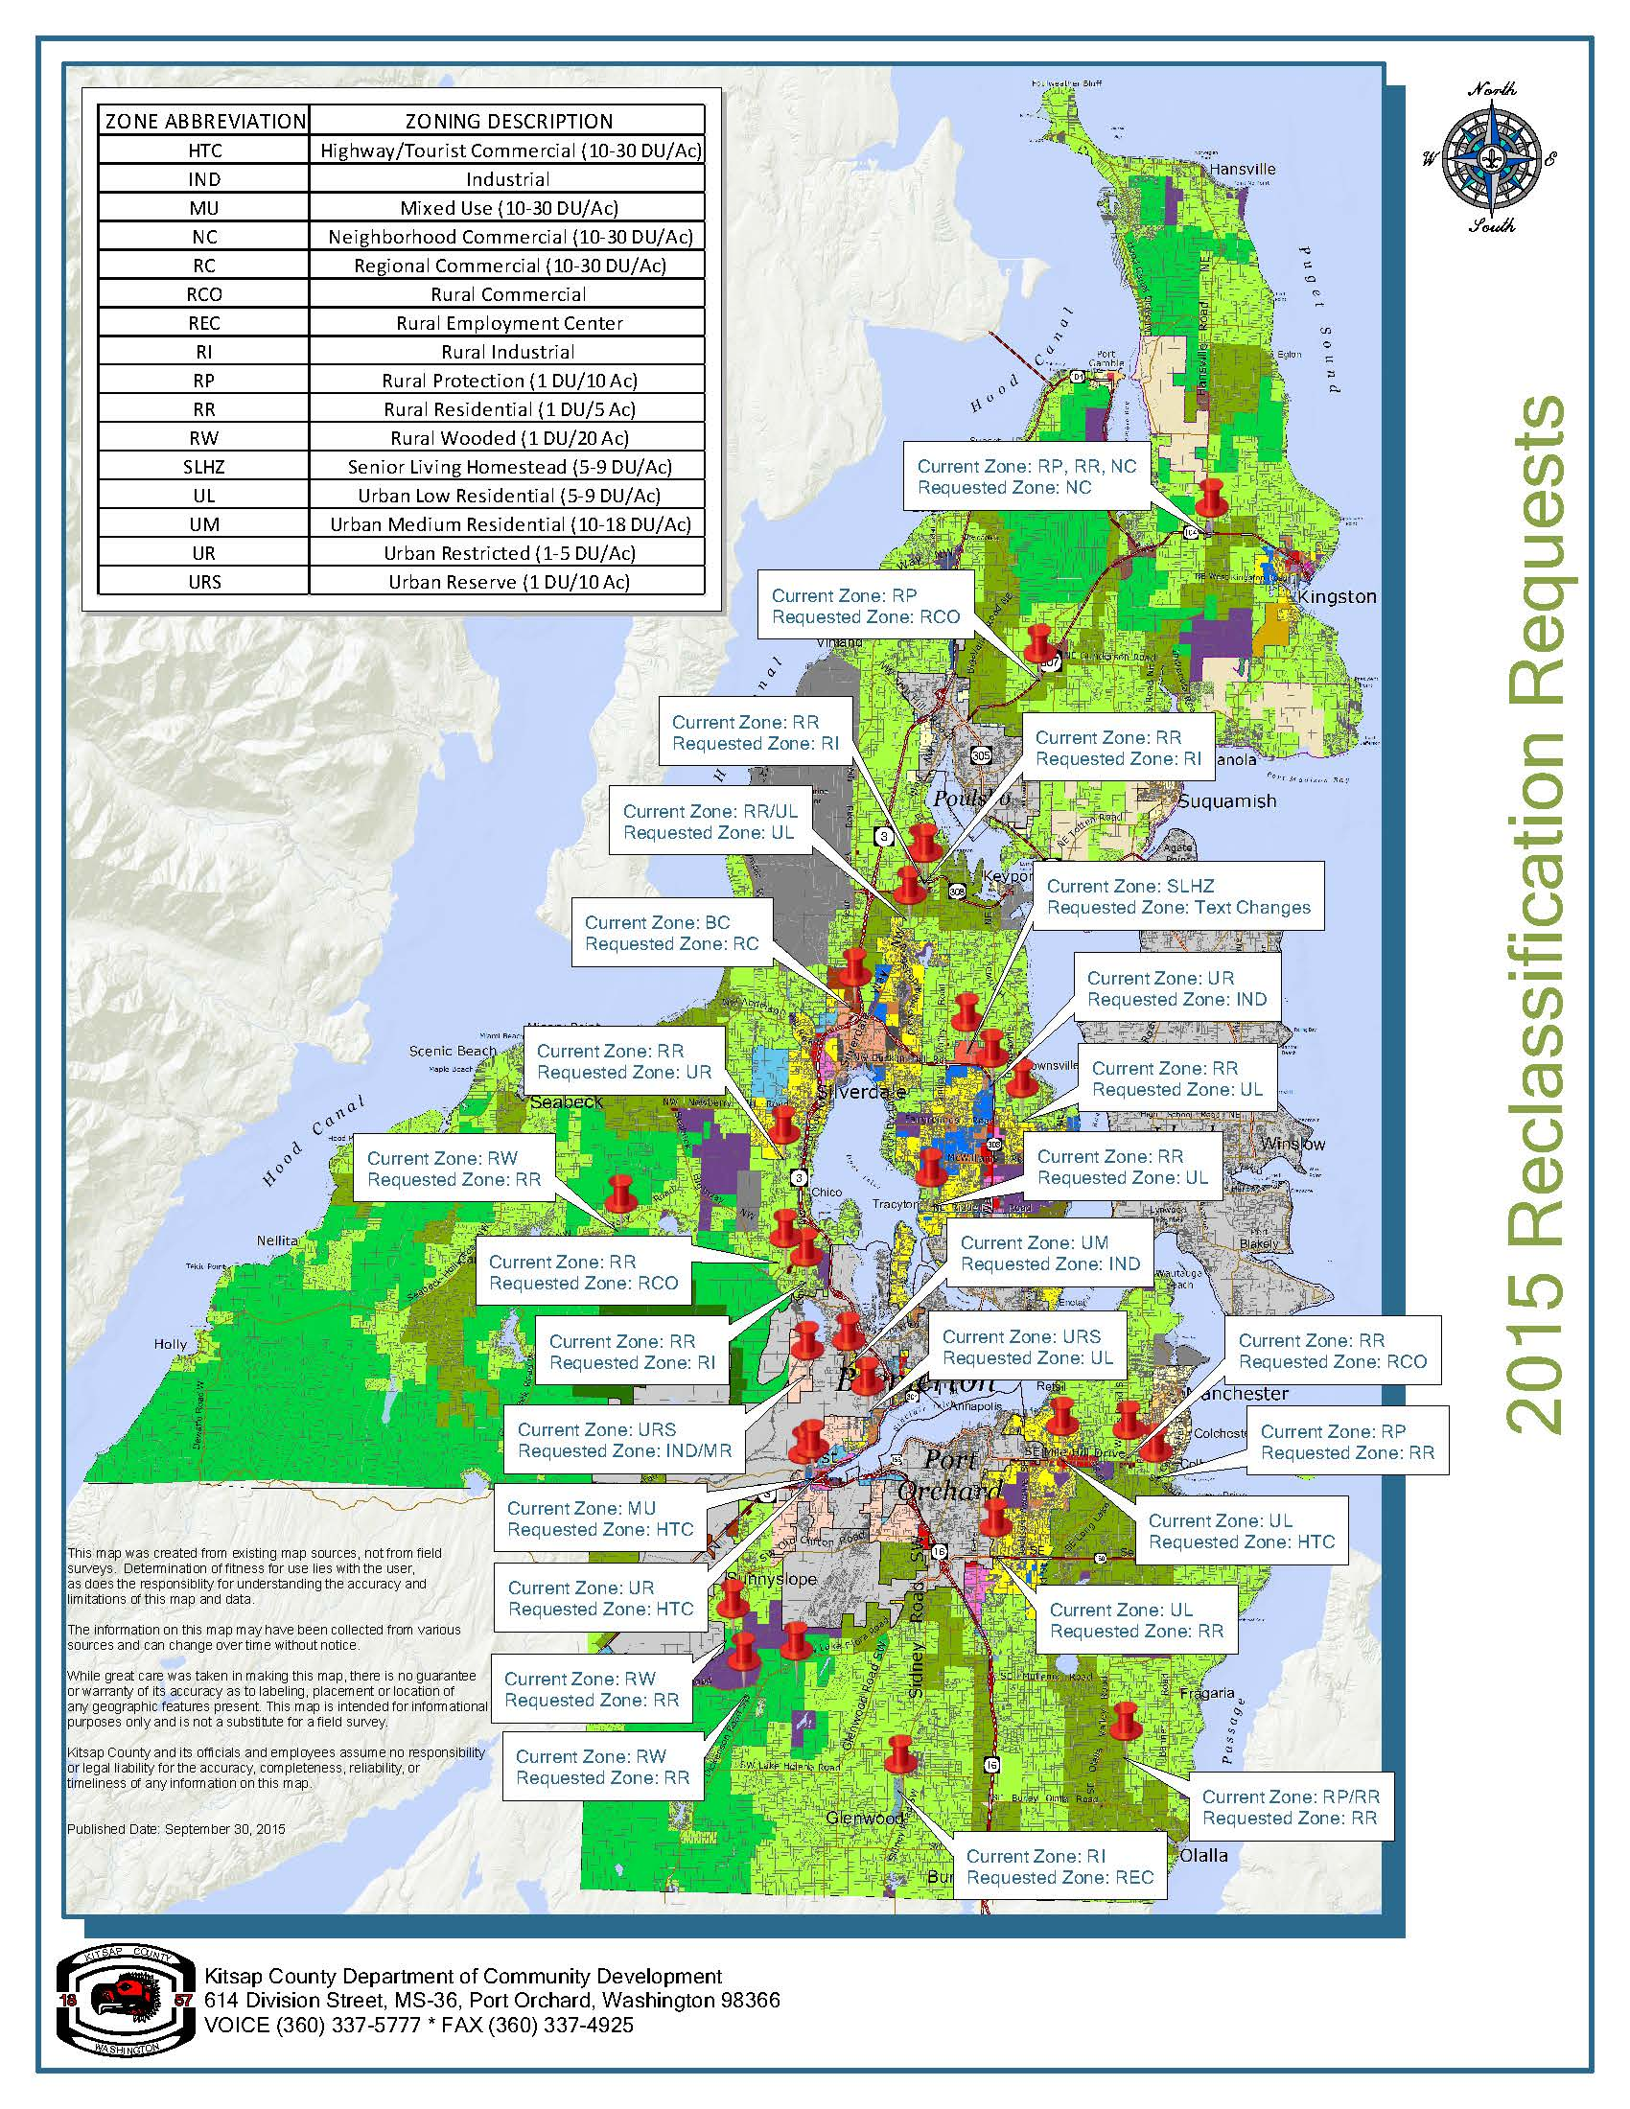
SEIS: Reclassification Requests

Slide 17
SEIS: Affected Environment, Potential Impacts and Mitigation Measures
Natural Environment
  Earth
  Air Quality
  Water Resources (Surface and Ground)
  Plants and Animals
Built Environment: Land Use and Transportation
  Land and Shoreline Use
  Relationship to Plans and Policies
  Population, Housing and Employment
  Transportation
Built Environment: Public Services and Capital Facilities
  Public Buildings
  Fire Protection
  Law Enforcement
  Parks and Recreation
  Schools
  Solid Waste
  Wastewater
  Stormwater
  Water
  Energy and Telecommunications
  Library

Slide 18
SEIS: Land Use Alternatives Overview

Slide 19
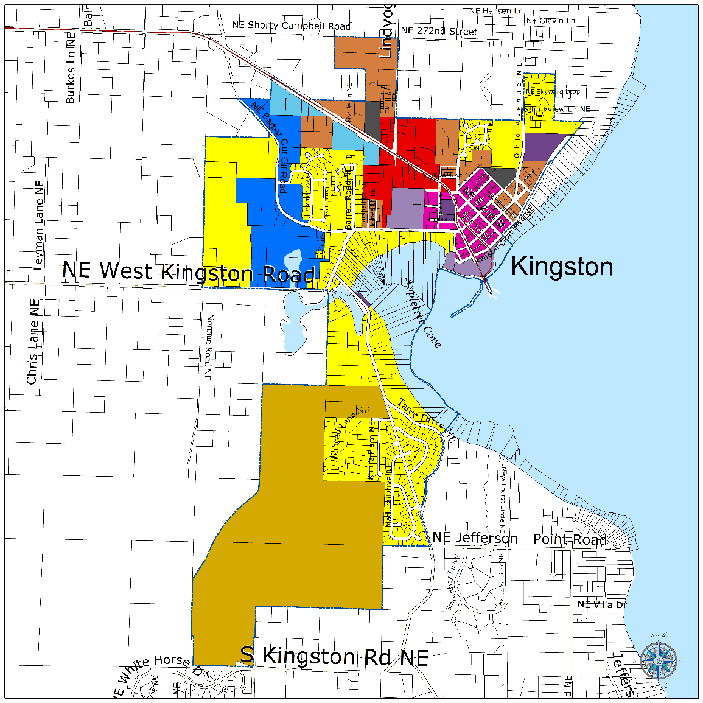

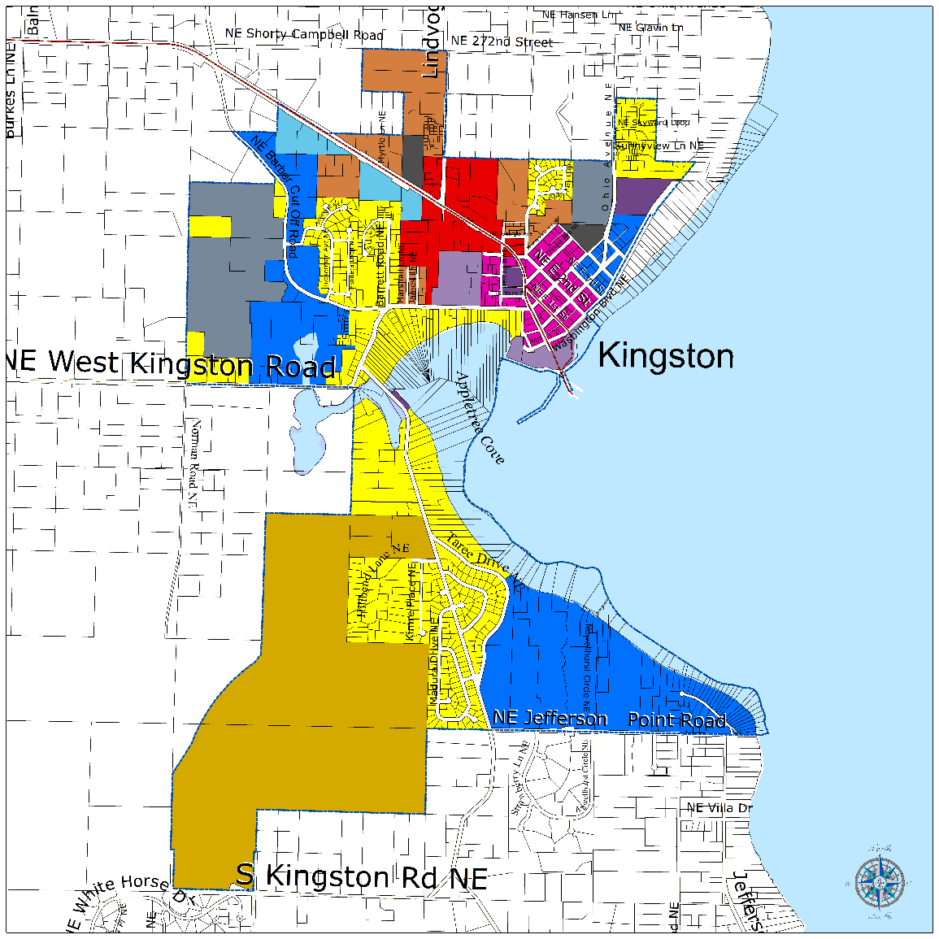
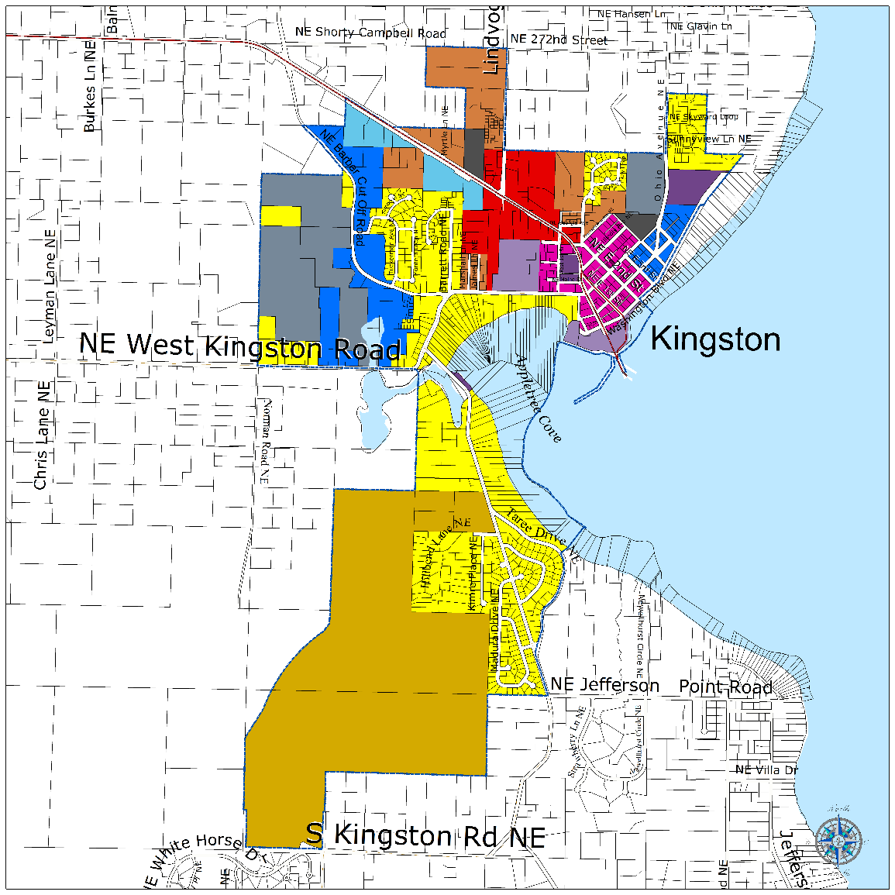

SEIS: Kingston UGA Land Use Alternatives

Slide 20
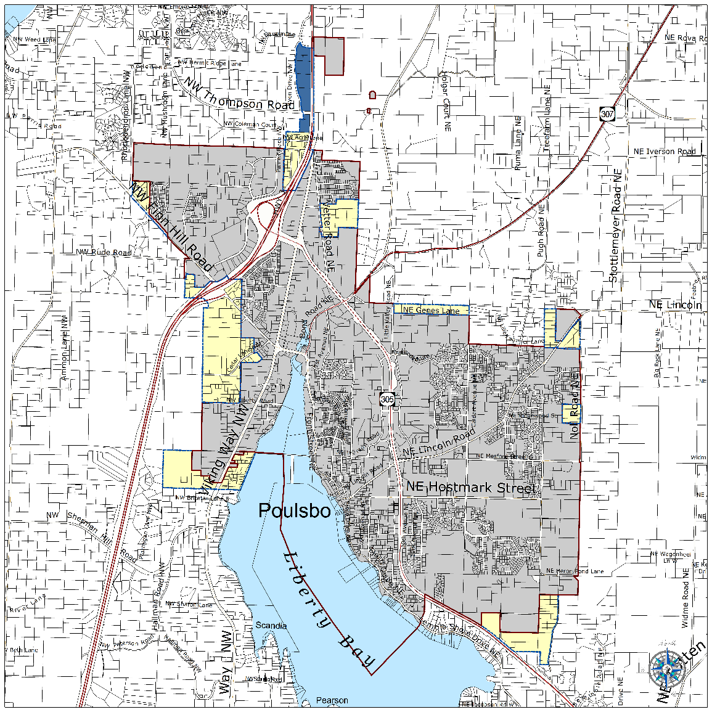
SEIS: Poulsbo UGA Land Use Alternative

Slide 21
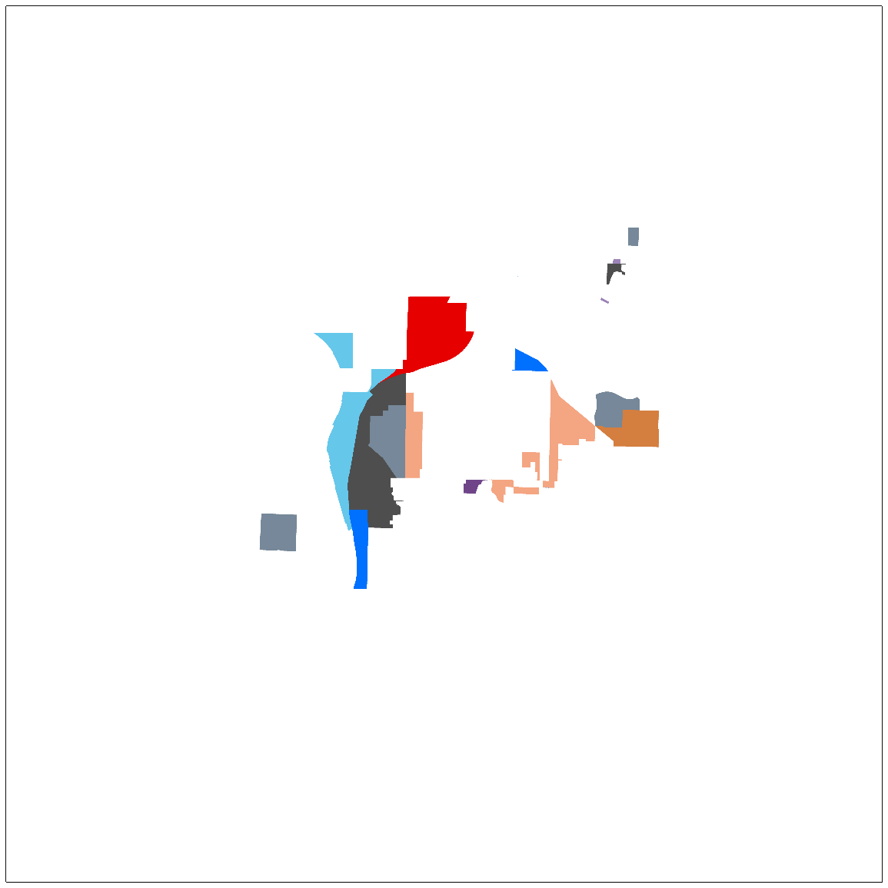
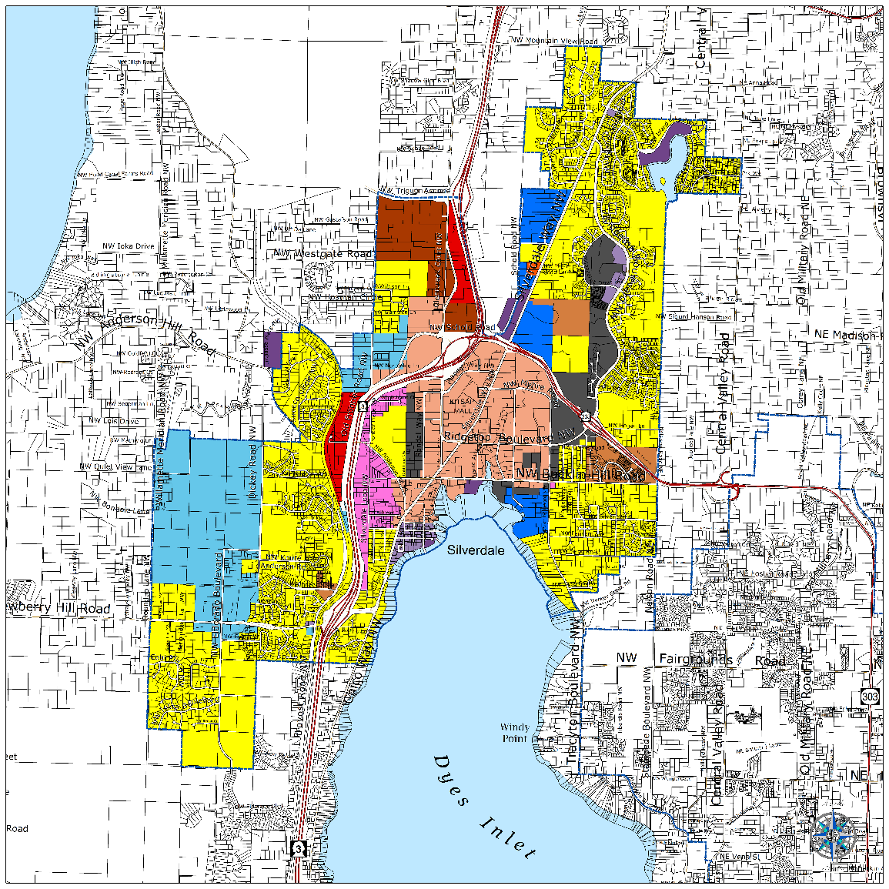
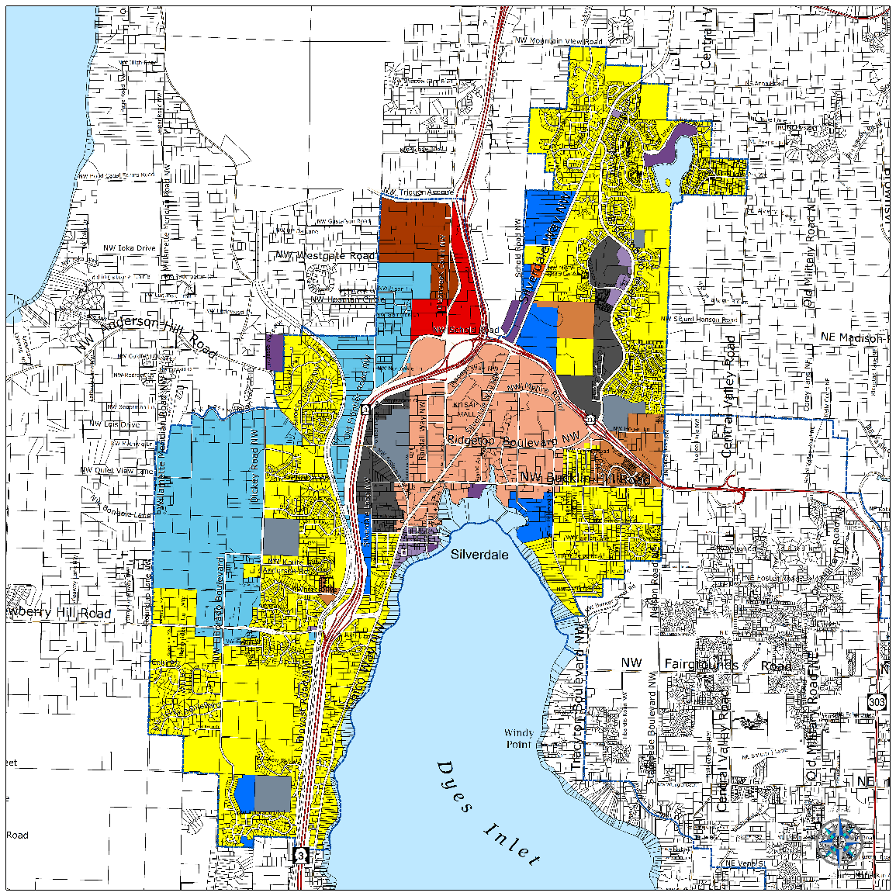
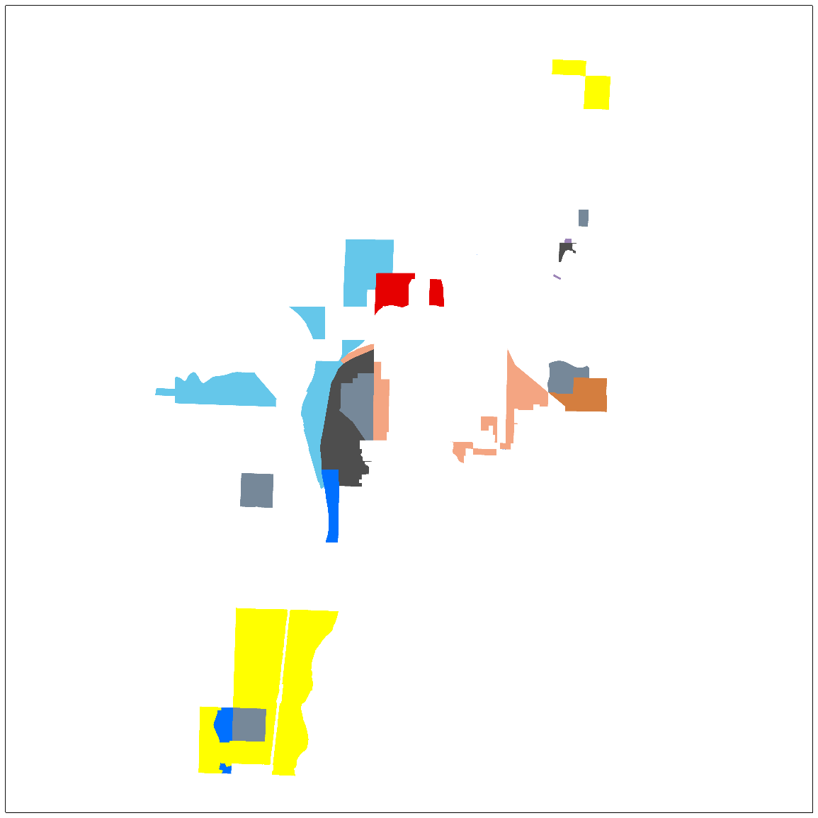
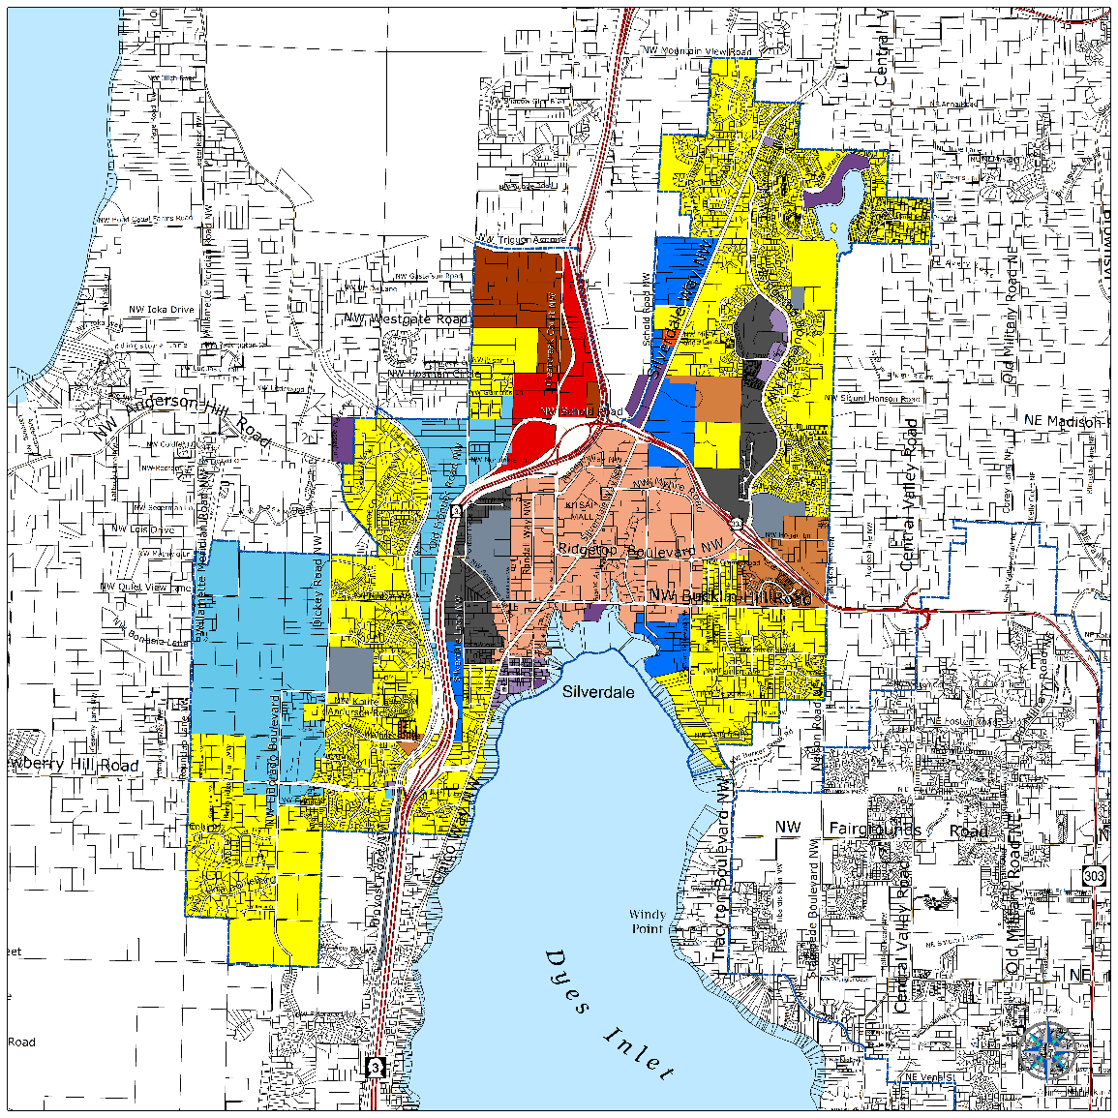
SEIS: Silverdale UGA Land Use Alternatives

Slide 22
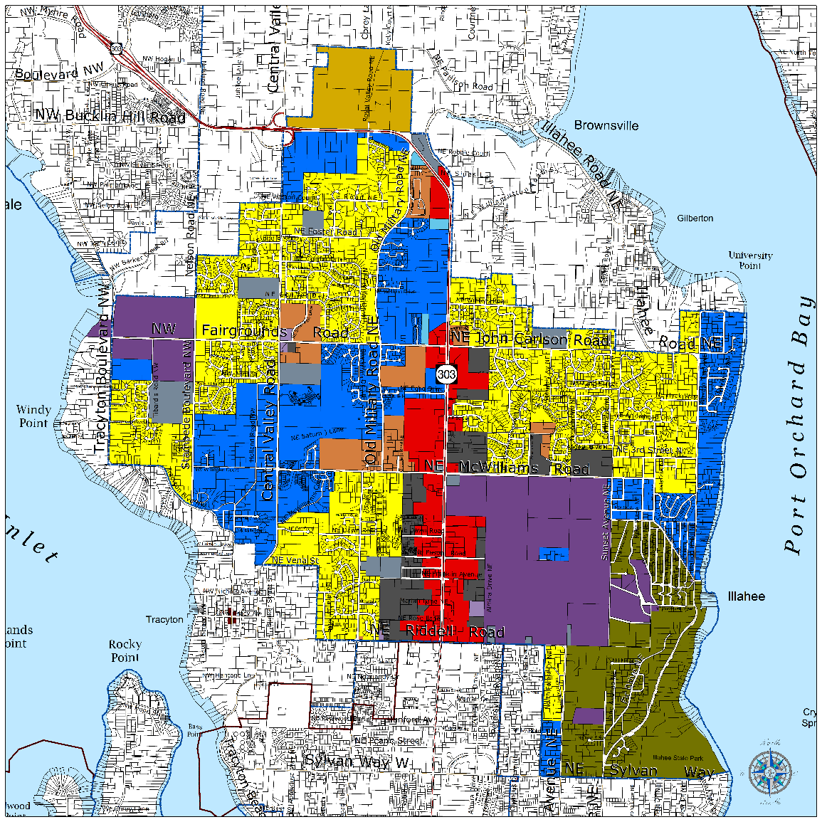
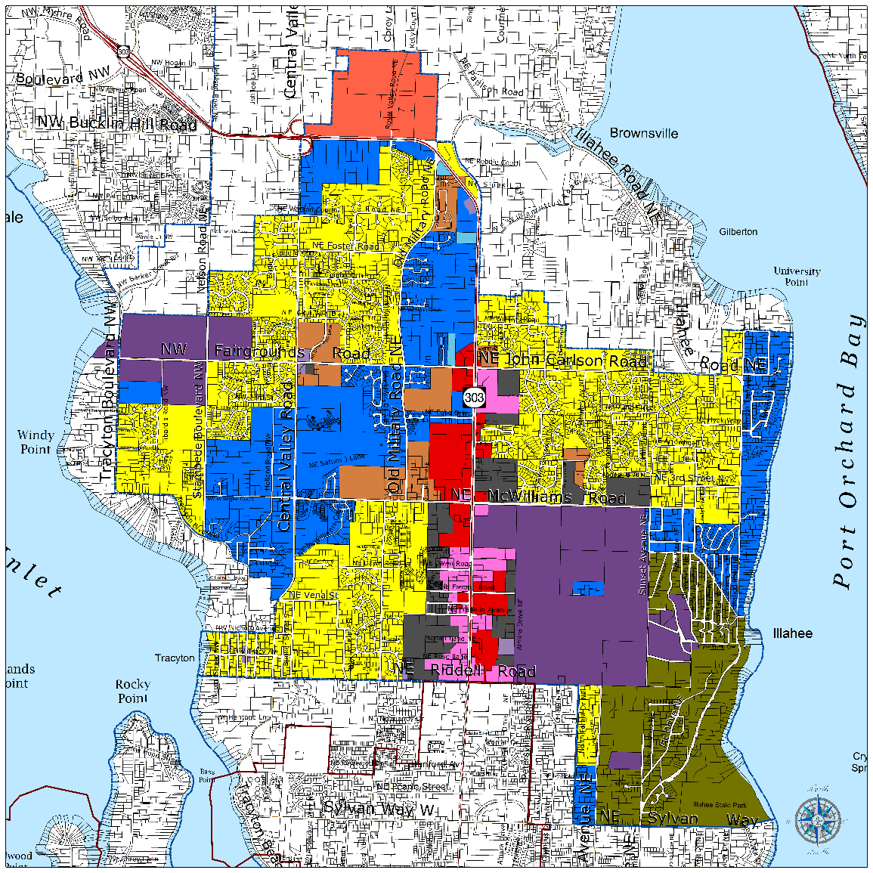
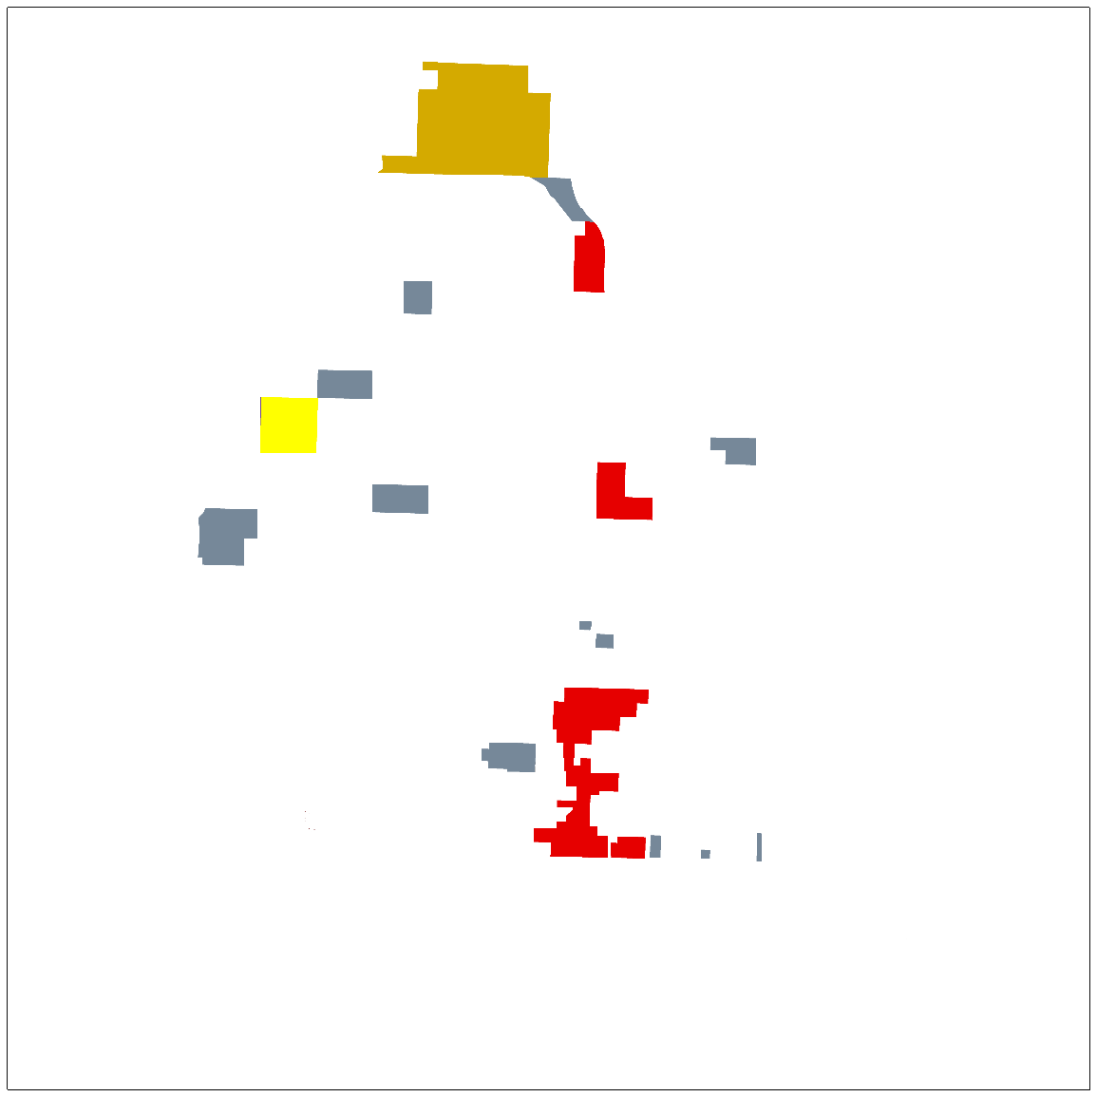
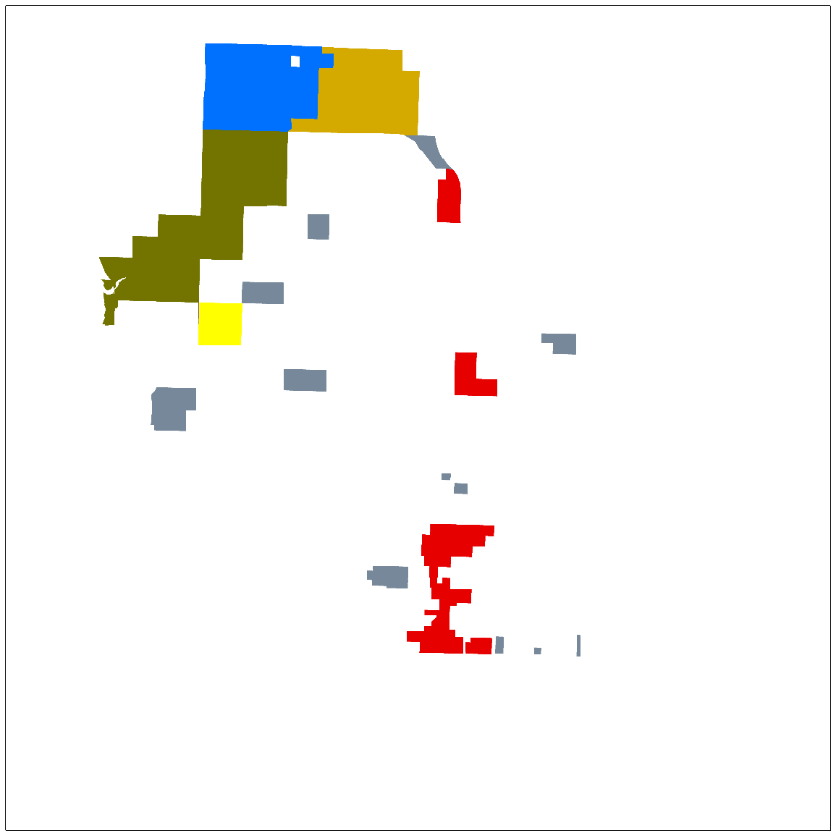
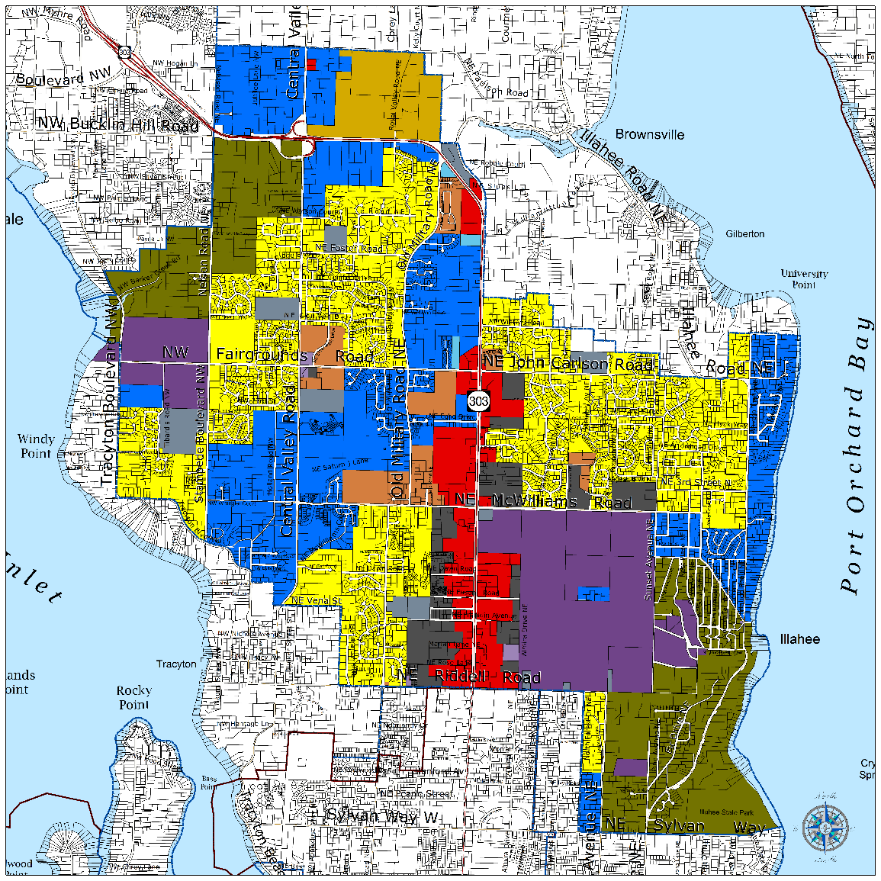
SEIS: Central UGA Land Use Alternatives

Slide 23
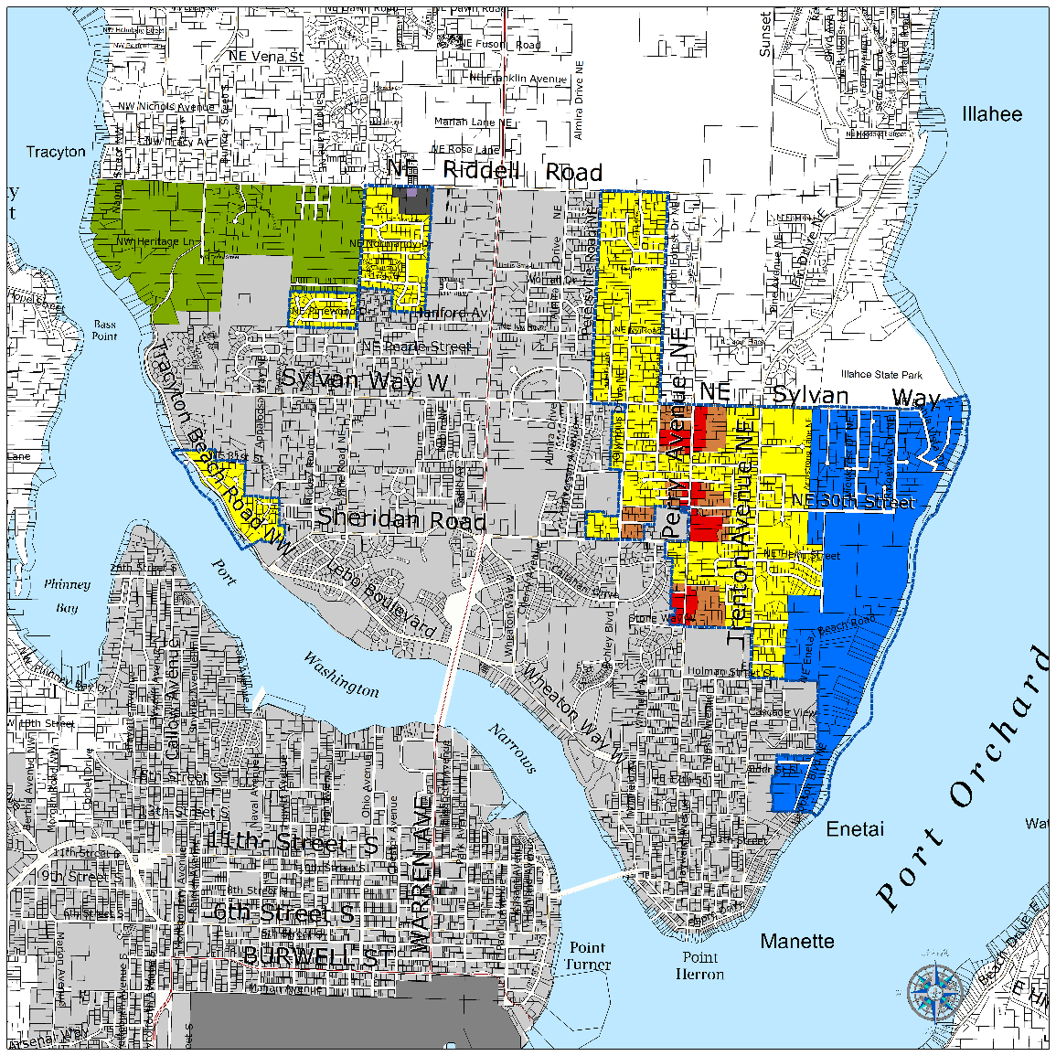
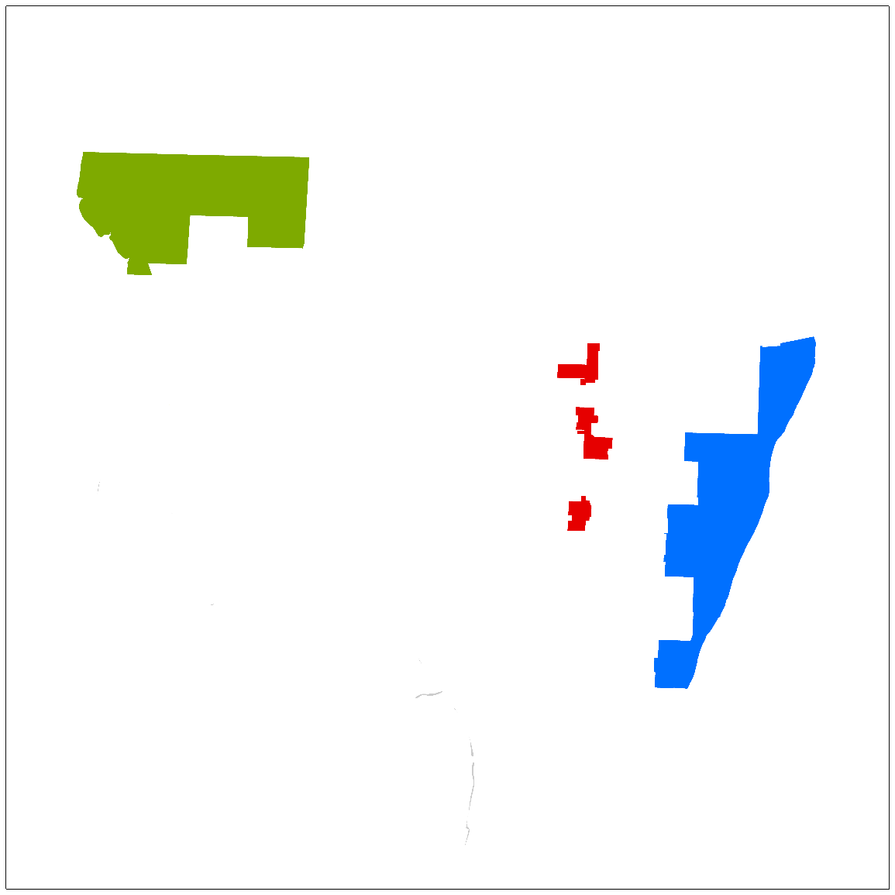
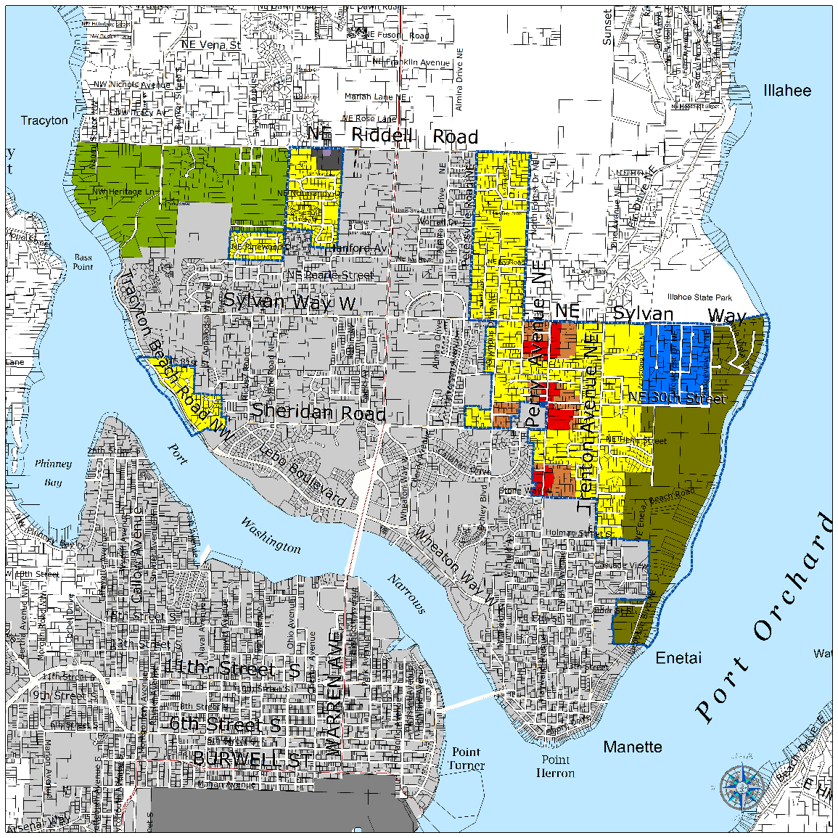
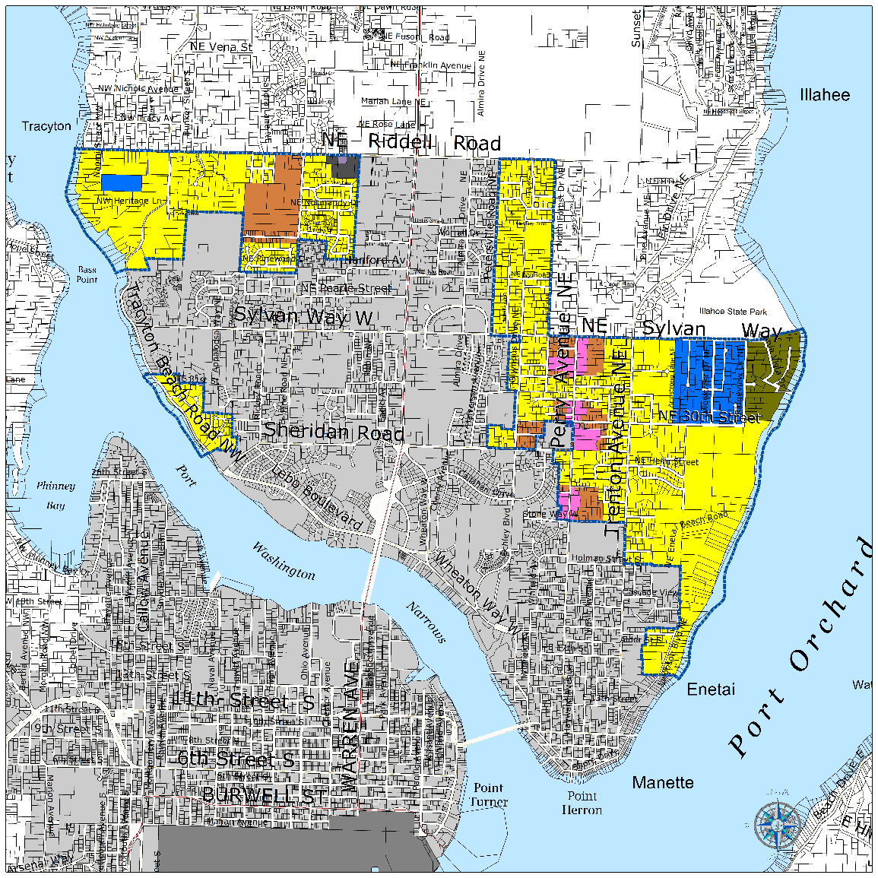
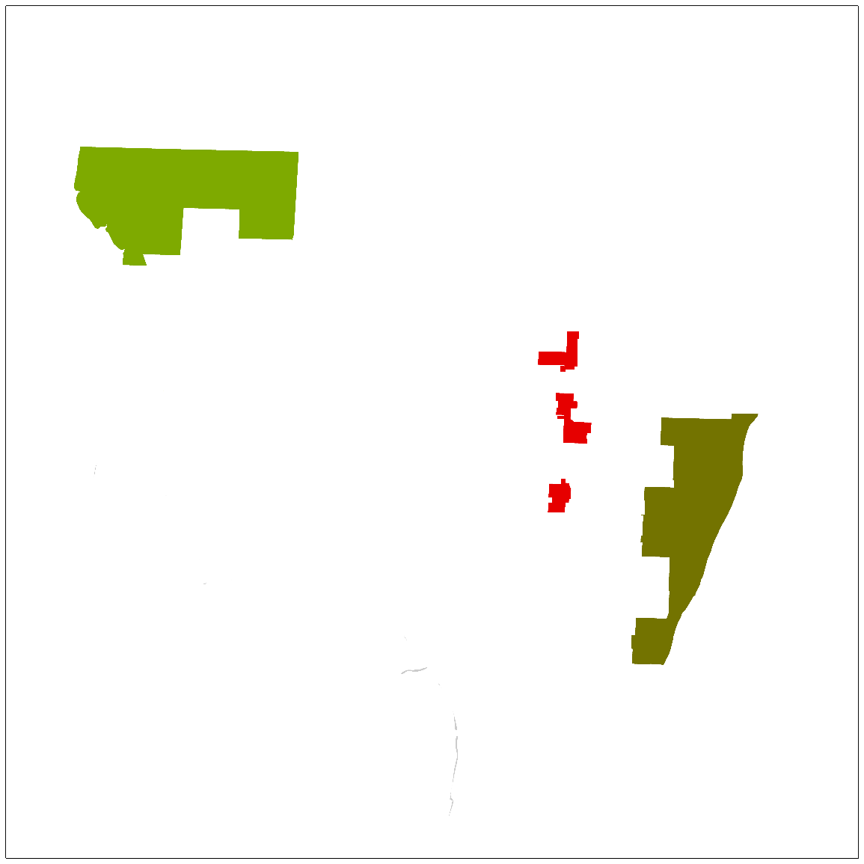
SEIS: Bremerton East UGA Land Use Alternatives

Slide 24
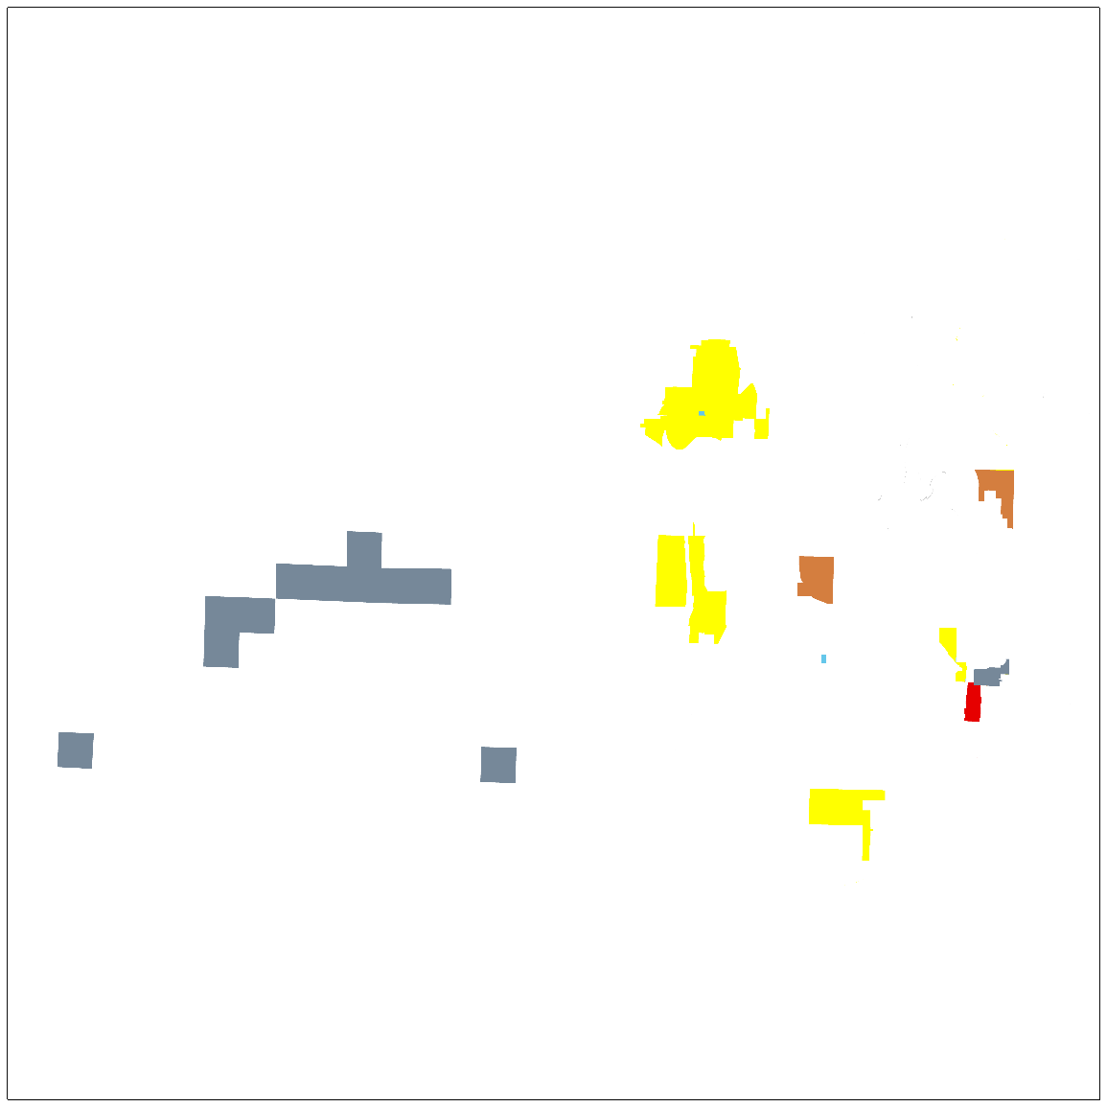
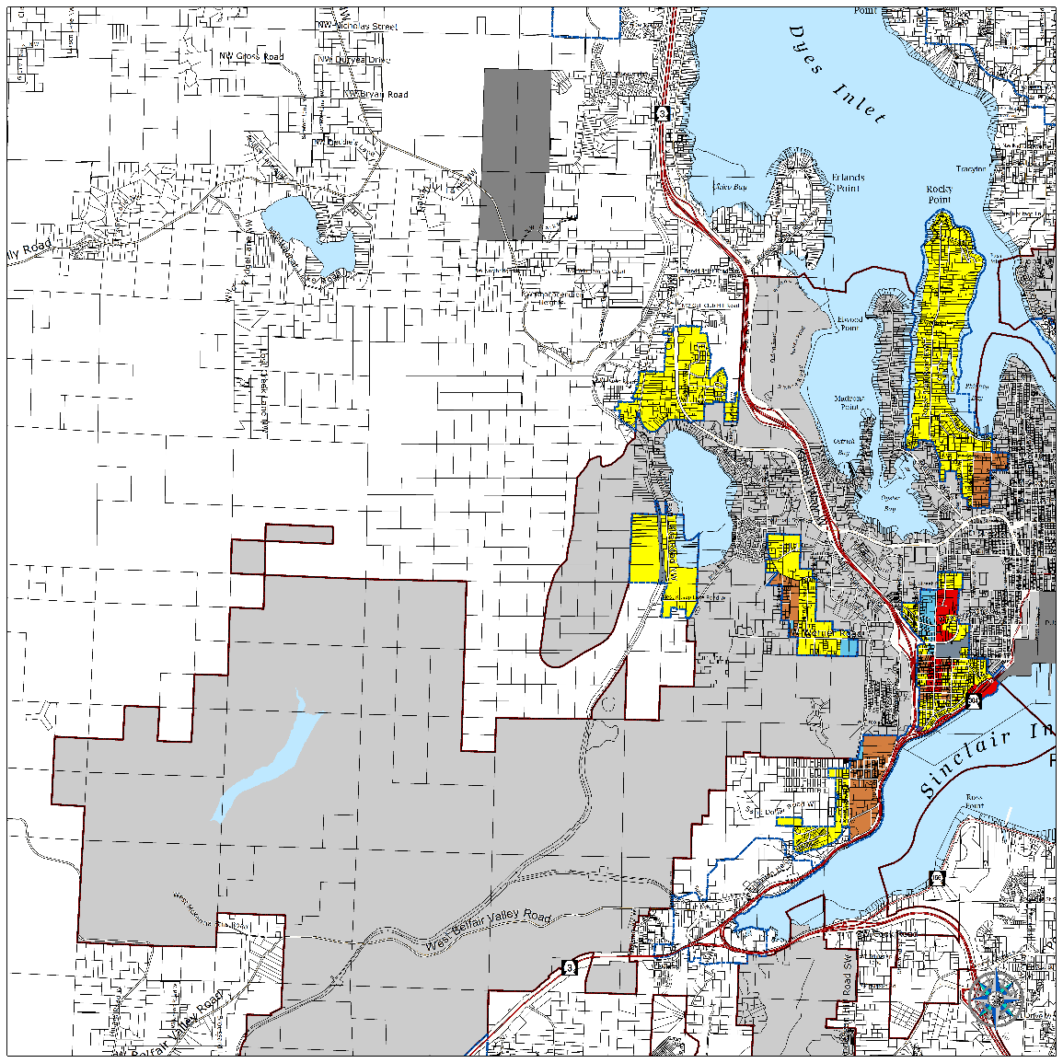
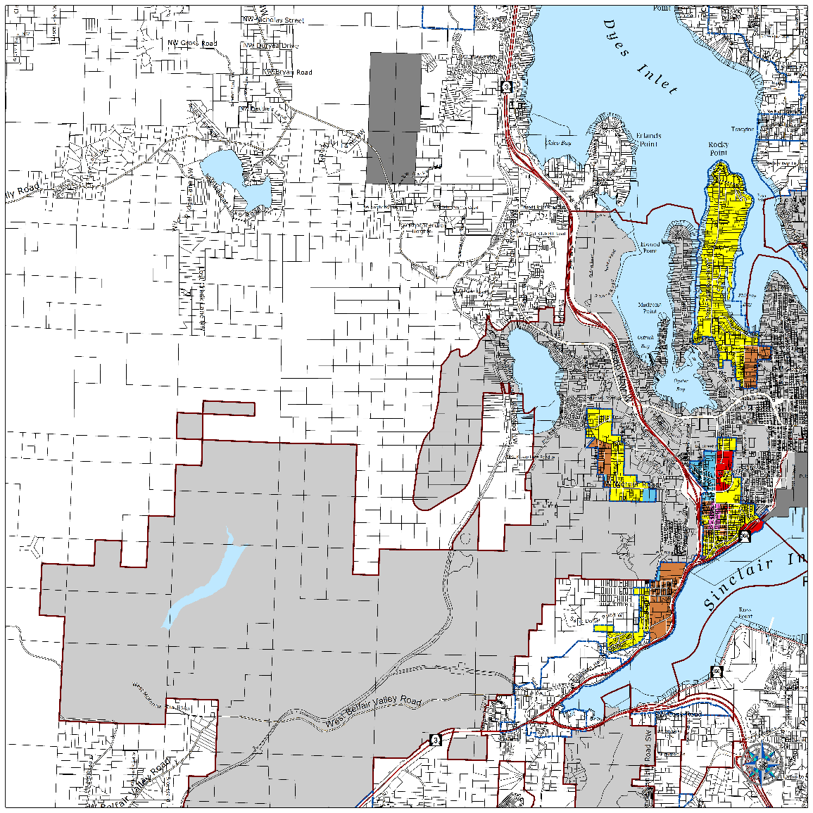
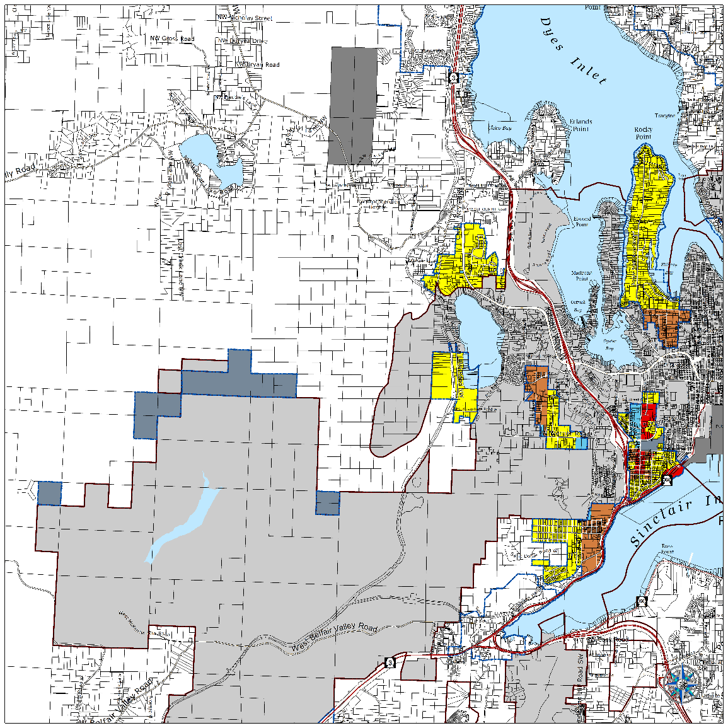

SEIS: Bremerton West UGA Land Use Alternatives

Slide 25
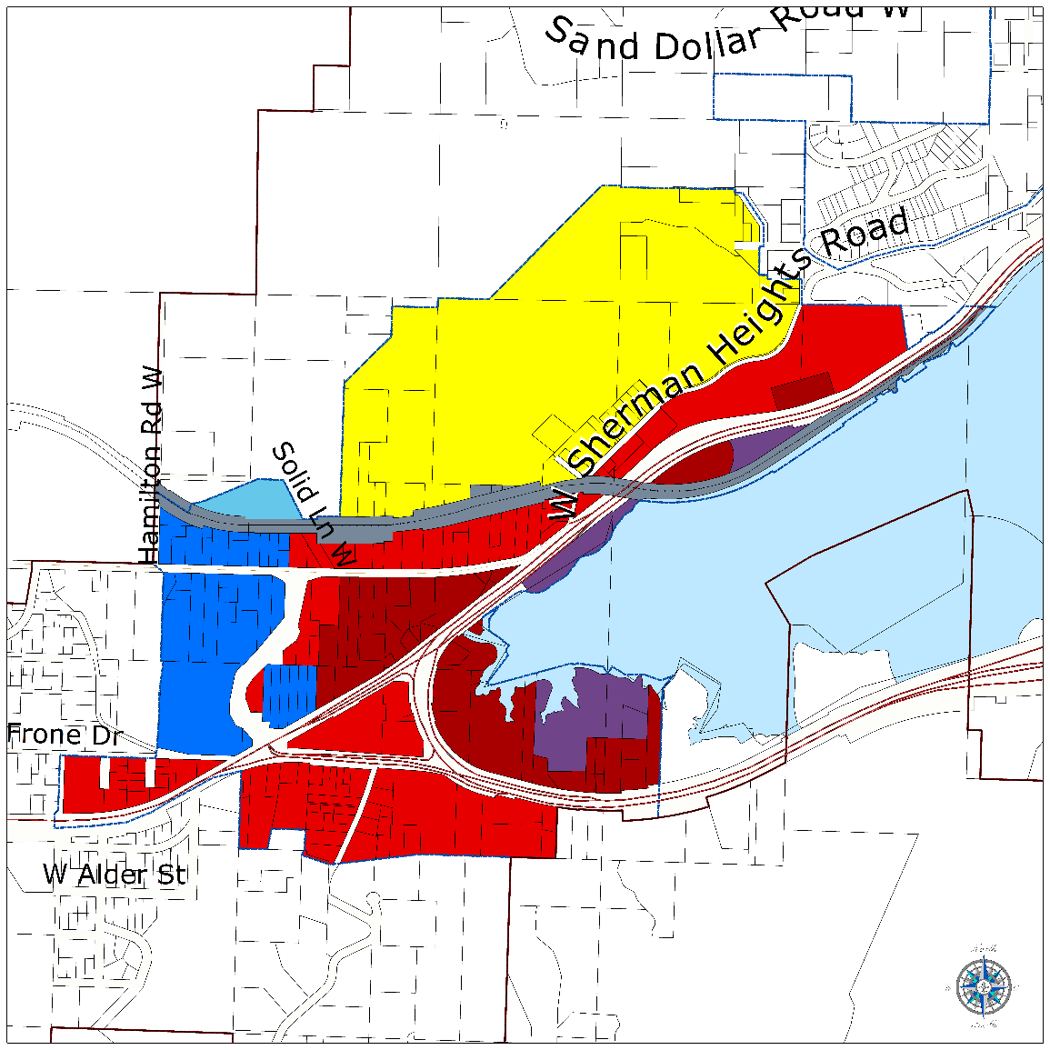
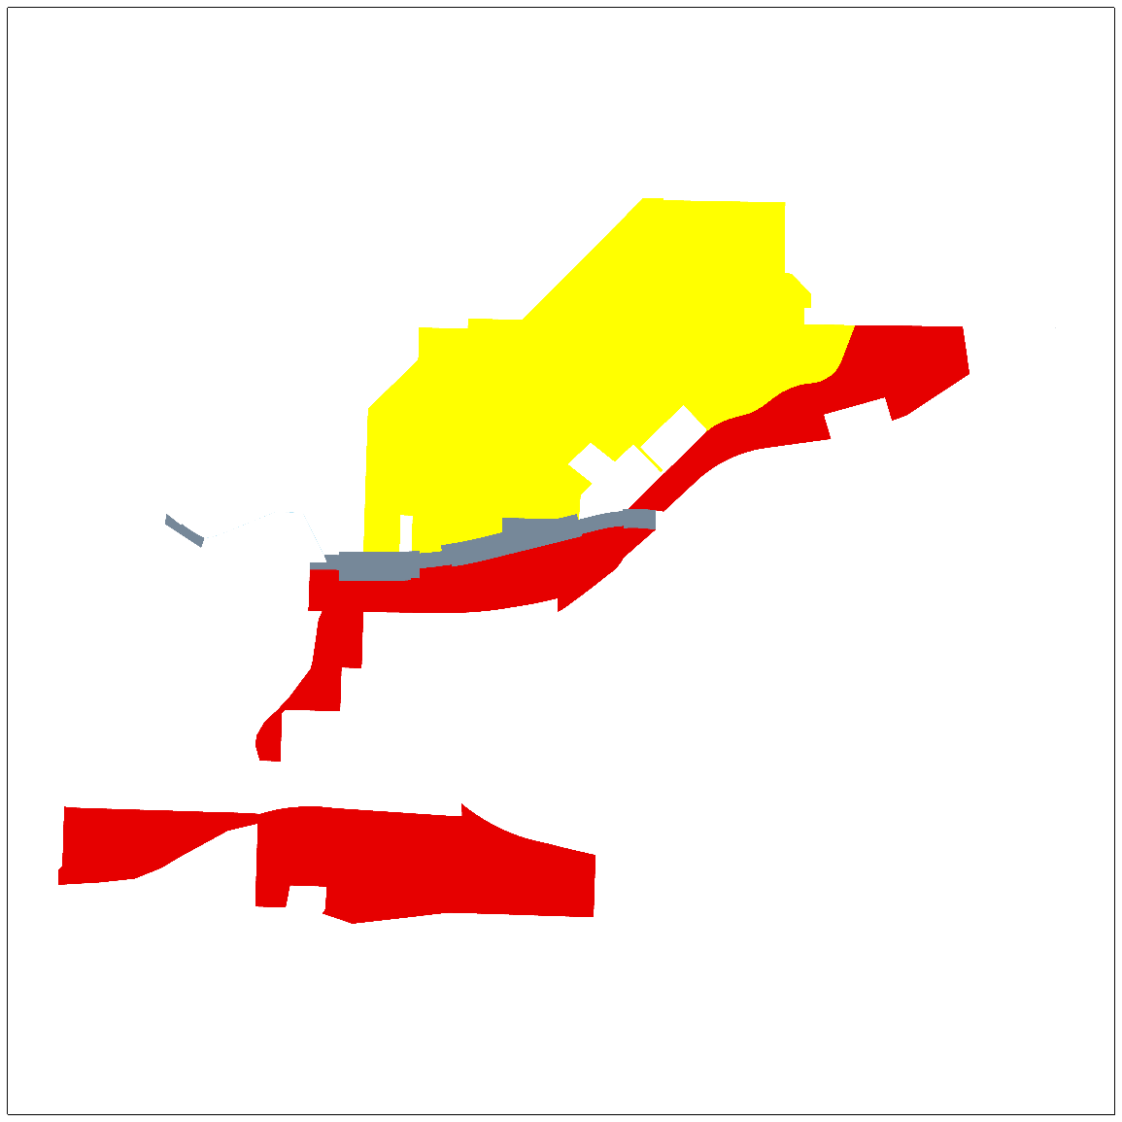
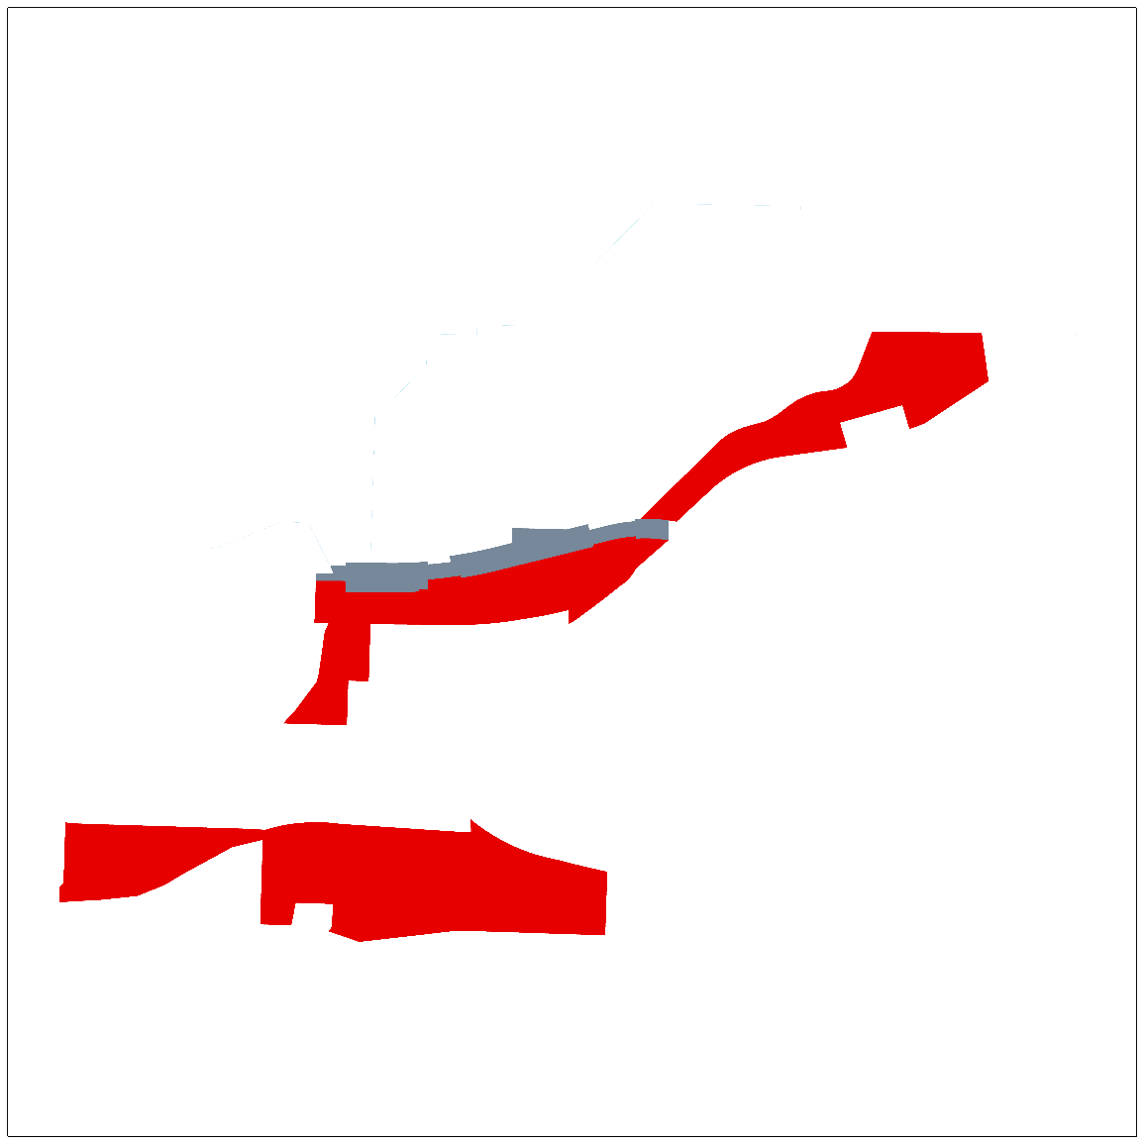
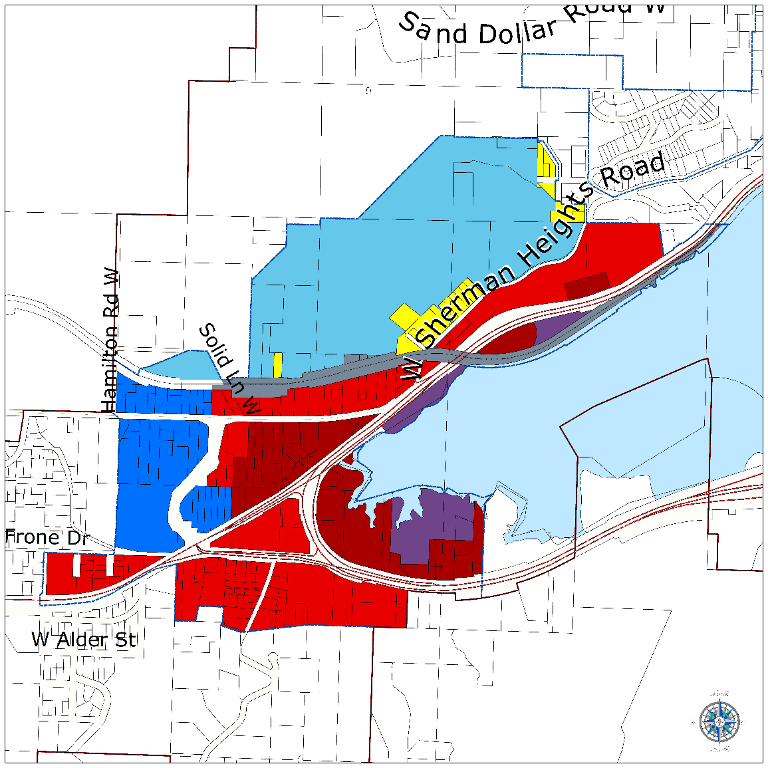
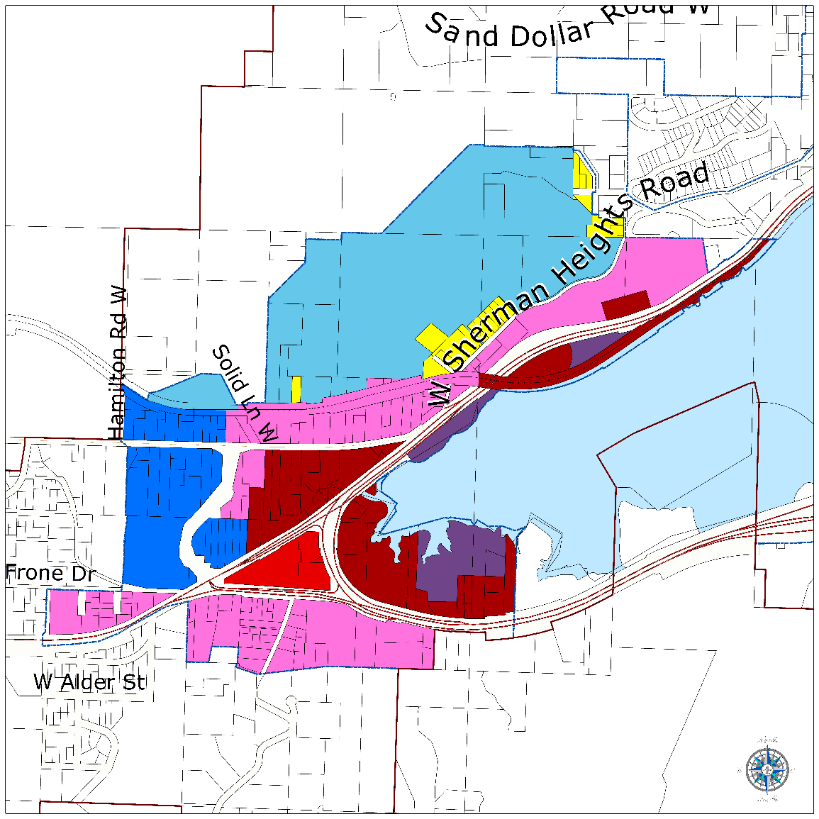
SEIS: Bremerton Gorst UGA Land Use Alternatives

Slide 26
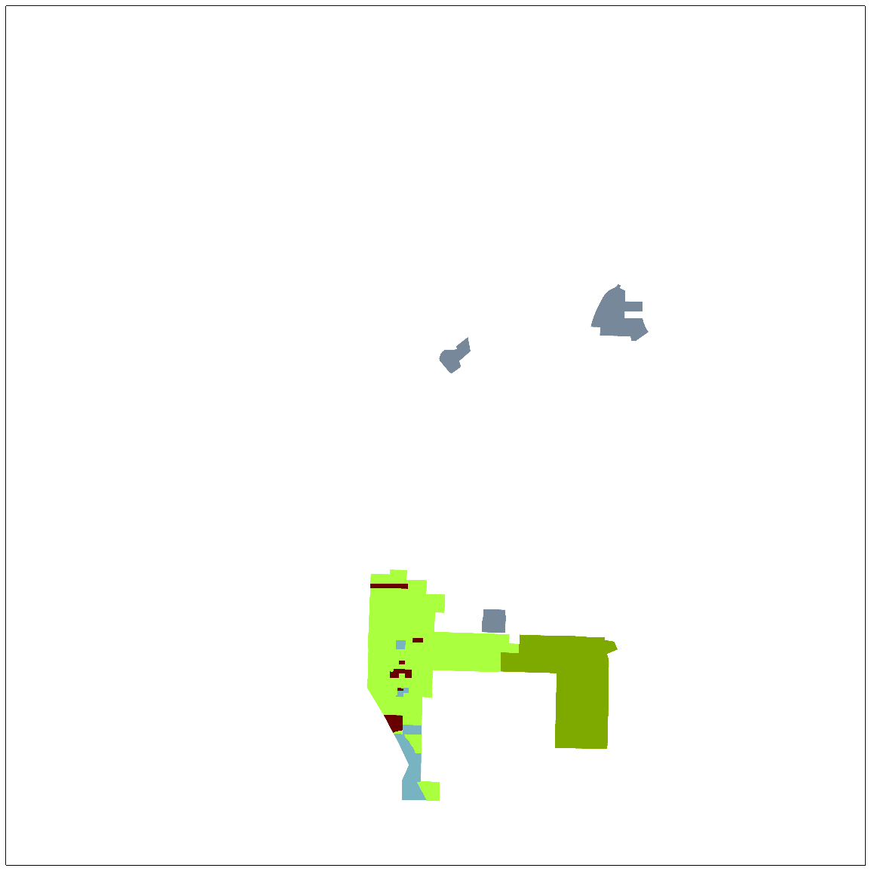
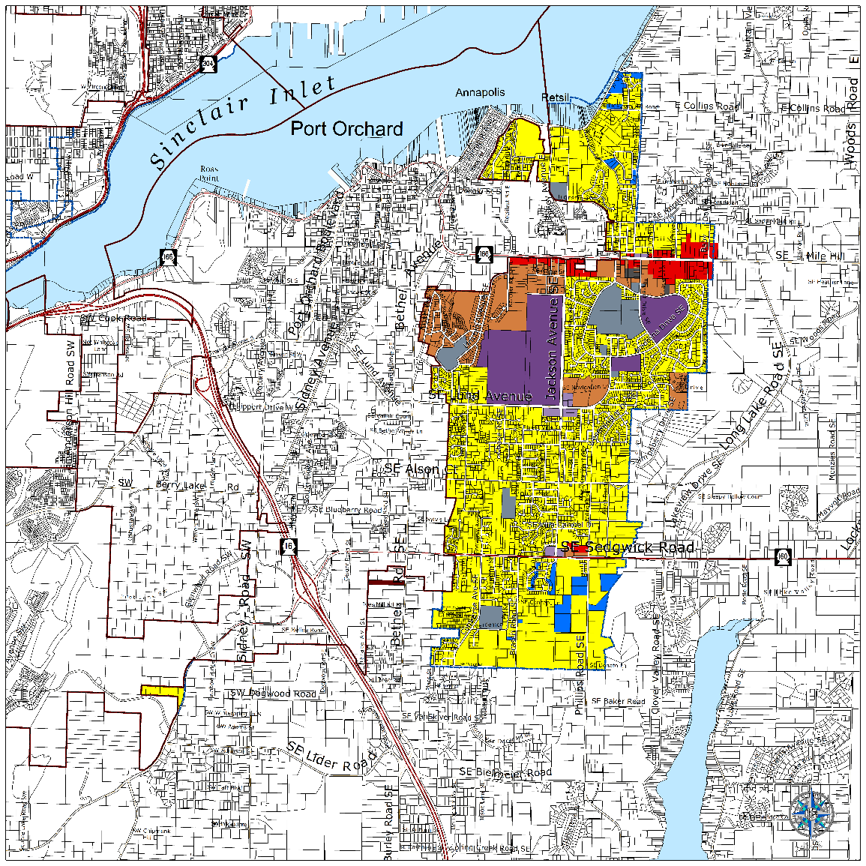
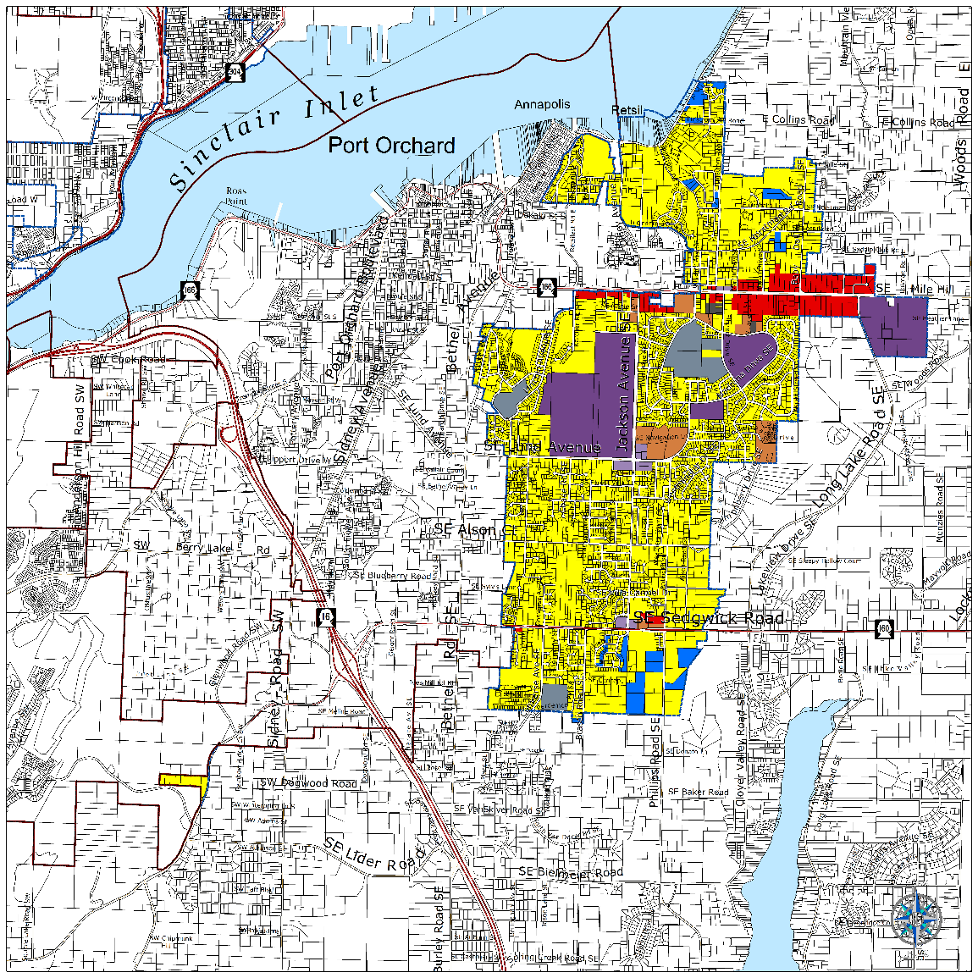
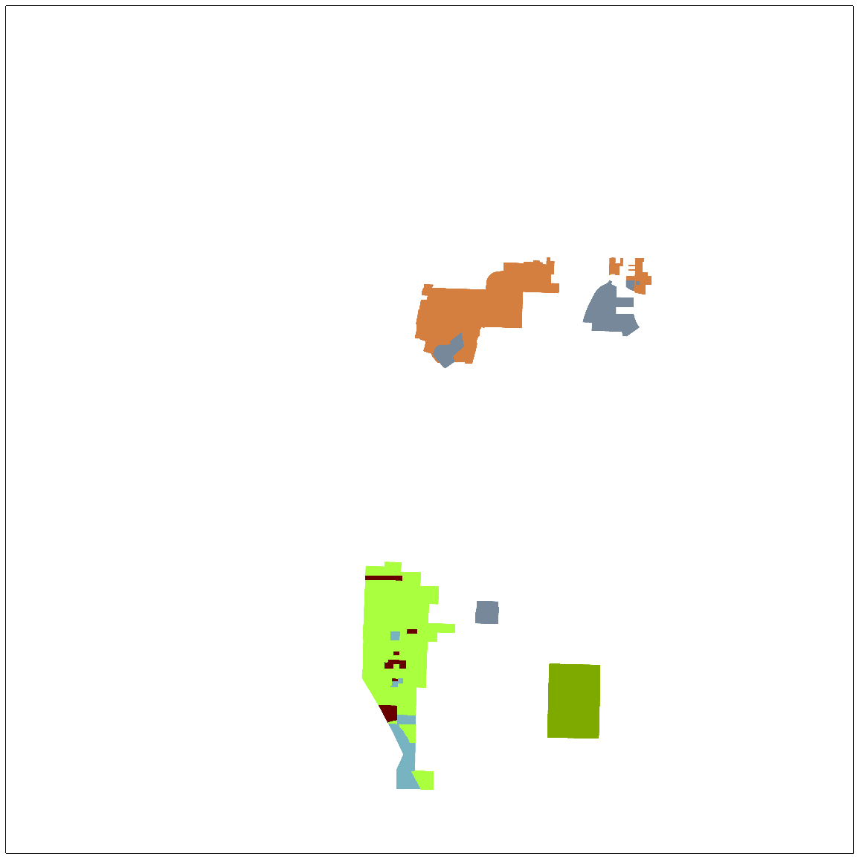
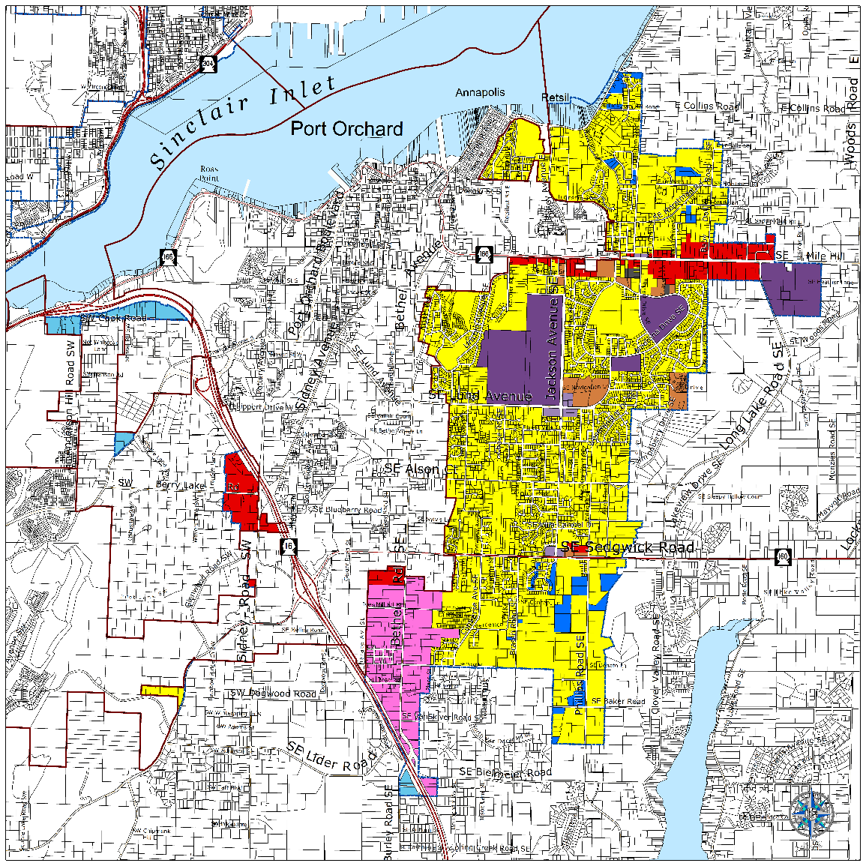
SEIS: Port Orchard UGA Land Use Alternatives

Slide 27
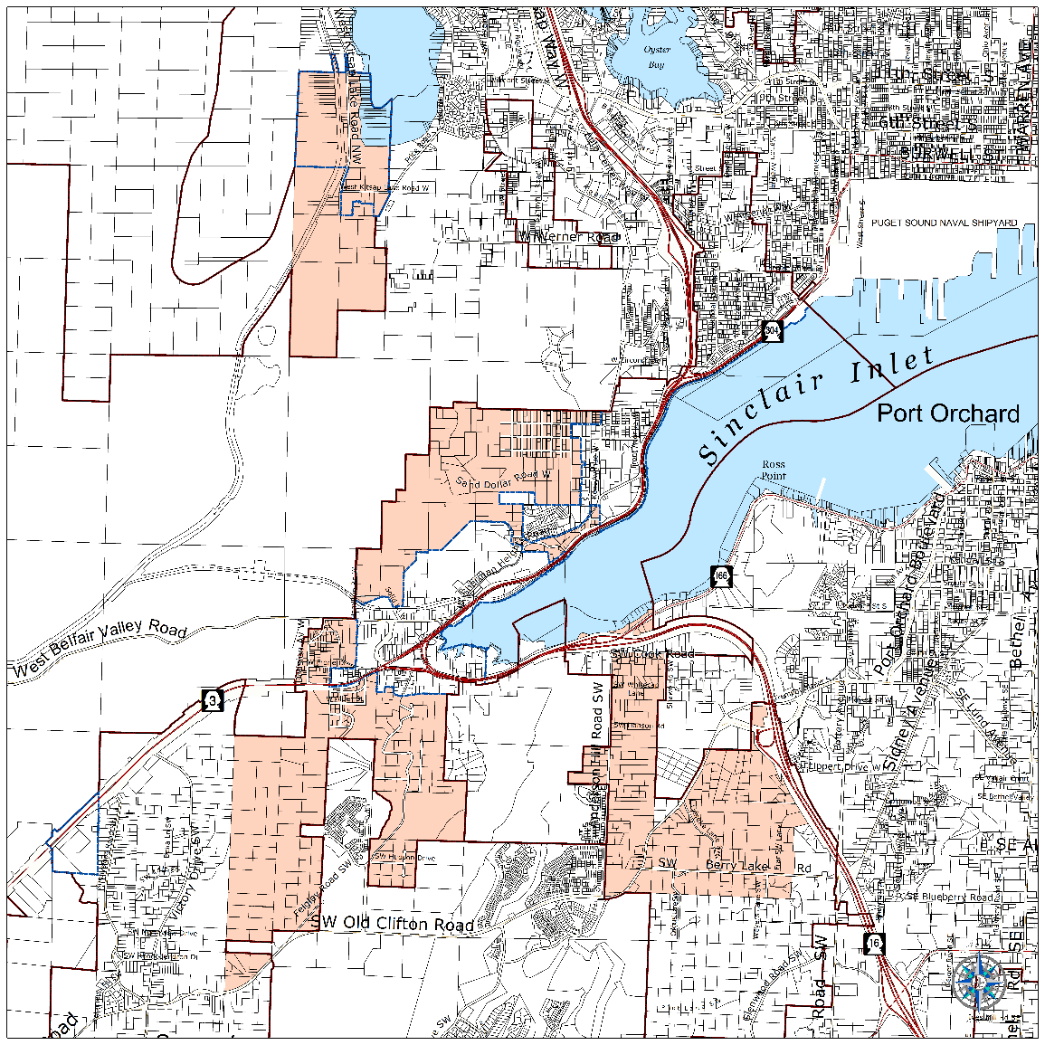
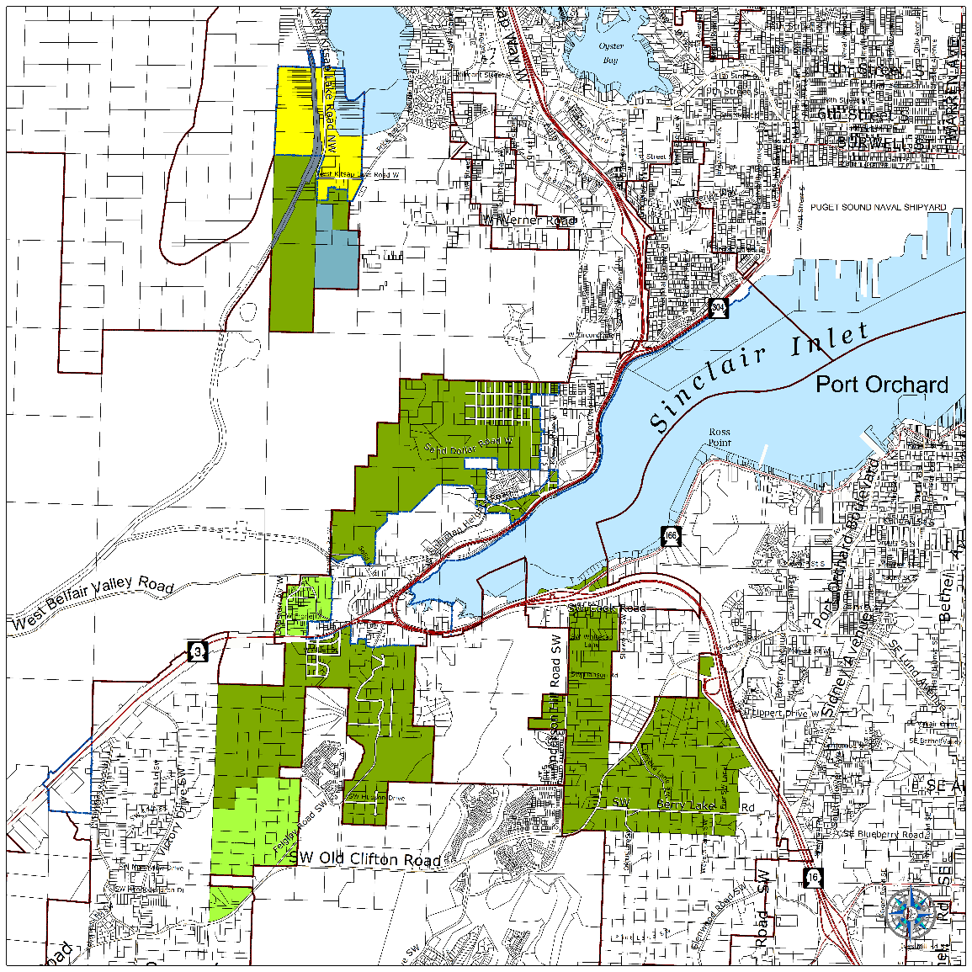
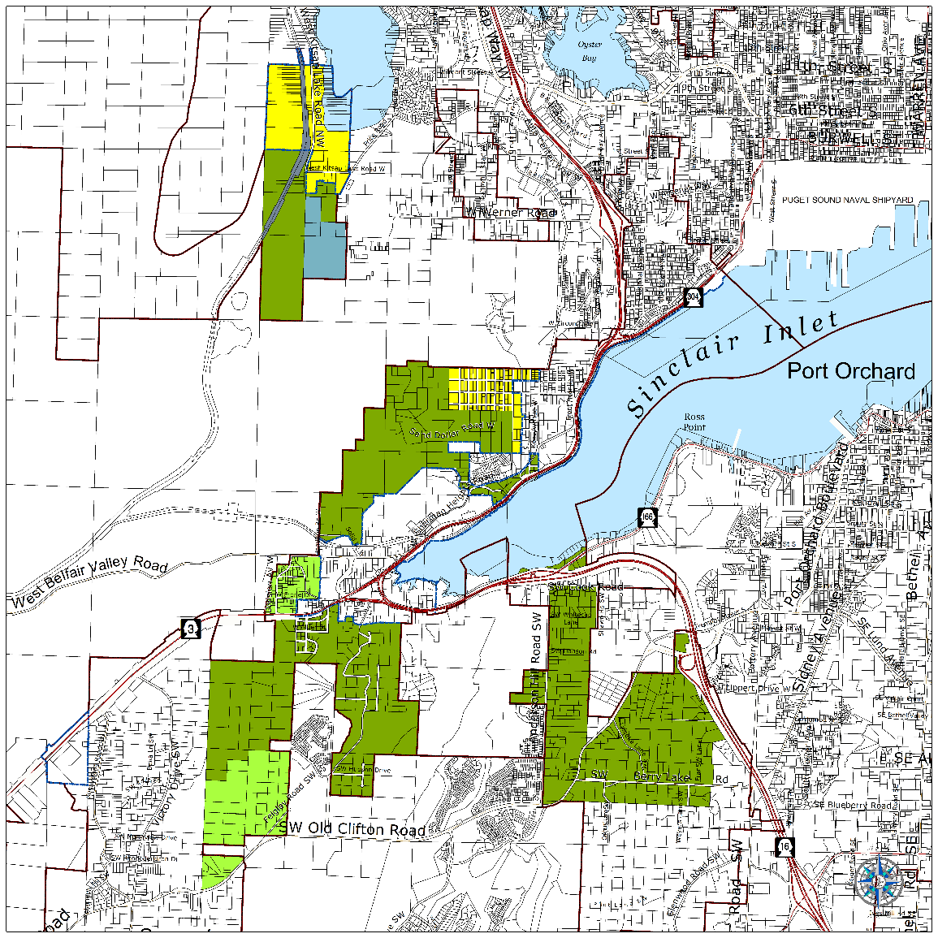
SEIS: Urban Reserve Alternatives

Slide 28

Capital Facilities Plan (CFP)
Growth Management Act Requirements
  Capital Facilities Plan Element
    Plan for water systems, sewer systems, stormwater systems, schools, parks and recreation facilities, police facilities and fire facilities.
    Ensure facilities are in place or have funding commitments to support growth at desired Levels of Service.
  Utilities Element
    Plan for power, gas, telecommunications.
    Coordinate with utility providers

Slide 29

Contents of the CFP
Plan Chapters
1.0 Plan Foundation
2.0 Comprehensive Capital Facility Plan
3.0 Revenue Analysis
4.0 Service Area and Infrastructure Detail
Plan Appendices
Appendix A. Sewer System Maps 2036- No Action
Appendix B. Sewer System Costs and Revenues
Appendix C. Alternative Sewer Costs
  4.1 Administration: Public Buildings
  4.2 Public Safety: Law Enforcement
  4.3 Public Safety: Fire Protection
  4.4 Parks and Recreation
  4.5 Schools
  4.6 Solid Waste
  4.7 Stormwater
  4.8 Transportation
  4.9 Wastewater: Sanitary Sewer
  4.10 Water

Slide 30
CFP Components
Capital Facilities Plan
Inventory
Level of Service Demand
Capital Projects
Funding
Growth - 6 and 20 years

Slide 31
CFP Growth Assumptions
Topic | Alternative 1 No Action | Alternative 2 Whole Community | Alternative 3 All Inclusive
Countywide Population: 2015 | 258,200 | 258,200 | 258,200
Unincorporated Population: 2015 | 171,940 | 171,940 | 171,940
Countywide Population: 2021 | 277,903 | 278,313 | 278,697
Unincorporated Population: 2021 | 183,503 | 182,850 | 183,223
Countywide Population: 2036 | 329,923 | 331,550 | 333,076
Unincorporated Population: 2036 | 215,926 | 213,251 | 214,778

Slide 32
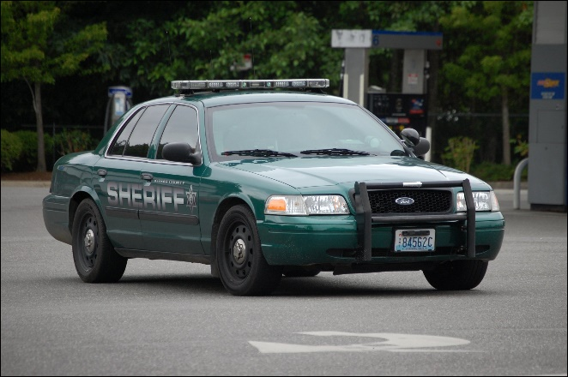
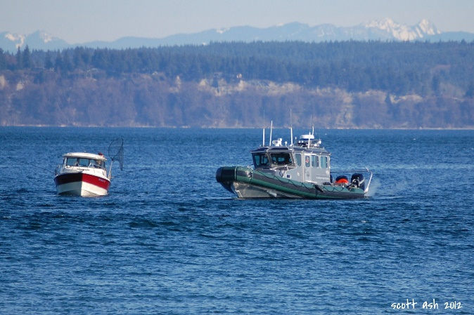
CFP: Sheriff Facility – Inventory
Sheriff administration and operations offices: 23,540 square feet
Sheriff’s office storage space: 13,210 square feet
Sheriff’s office corrections jail facility: 519 beds
Sheriff’s Office Car | Kitsap County Rescue Boat

Slide 33
CFP: Level of Service
Service | Current LOS | Proposed LOS
Sheriff’s Office | 129 square feet per 1,000 unincorporated population | 100 square feet per 1,000 unincorporated population
County Jail | 1.43 beds per 1,000 population | Incarceration rate: County Trend – 168 / 100,000 population* 20-year plan – 156 / 100,000 population
* Less than typical rate nationally of 234 per 100,000 population

Slide 34
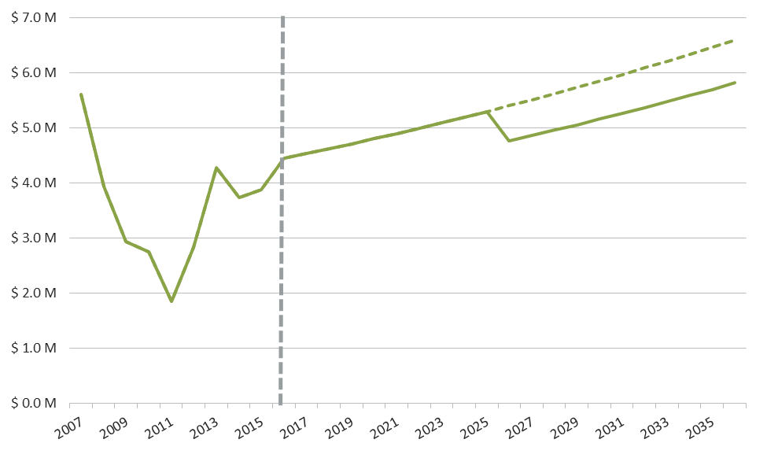
CFP: Revenue
Analysis addresses
  Dedicated Capital Revenues (transportation, parks, sewer, stormwater)
  General Capital Revenues – Real Estate Excise Tax (several categories, including law enforcement)
Kitsap County Real Estate Excise Tax Revenues (2007 – 2036 in YOE$)
For conservative assumption, includes possible Silverdale incorporation 10 years out.
The dotted line represents estimated future revenues if Silverdale did not incorporate and the current boundaries stayed the same.

Slide 35
CFP: Capital Facilities Needs
Pending needs assessment
  Possible need for additional storage space for property, vehicles, equipment, and training space (fire arms training).
  Possible need for office space in Silverdale and potentially in south Kitsap County.
The Needs Assessment will determine the future capital facilities projects for Sheriff facilities including offices, supporting facilities, and the jail.

Slide 36
CFP: County LOS Policy Choices
Analysis illustrates if 2012 LOS can be met with future growth – see Summary in Exhibit 2-3
Possibly lower LOS standards or add projects to address future growth
Facilities where LOS could be altered:
  Administration Buildings
  Community Centers
  Sheriff Offices
  County Jail – alter LOS to preferred standard of incarceration rate
  Work Release – no facility, remove standard
  Regional Parks – base LOS
  Community Parks – base LOS

Slide 37
CFP: Other Providers
Non-County Service Providers Addressed
  Fire Protection
  Schools
  Wastewater
  Water
Ensure that other municipalities serving UGAs and rural areas have adequate services and facilities, particularly those necessary to serve growth
Coordination via meetings and correspondence including providing alternative growth estimates

Slide 38
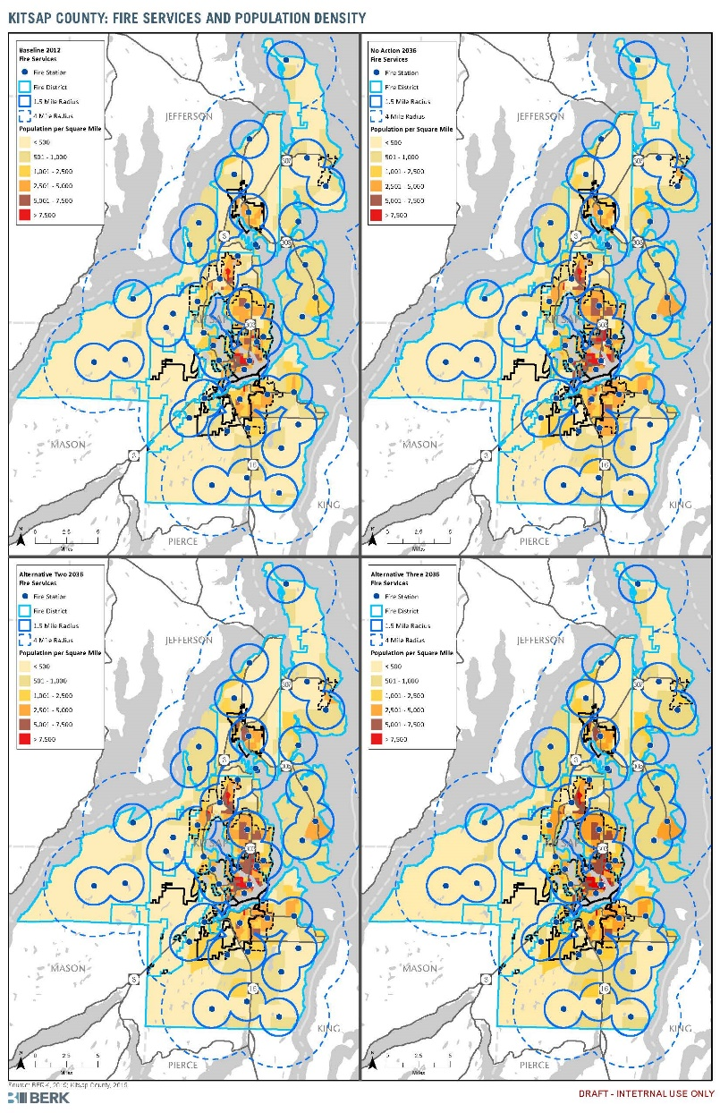
CFP: Other Provider LOS Highlight
2012 CFP proposed alternative Fire Protection LOS
New standard – reference Washington Surveying and Ratings Bureau (WSRB) Ratings:
  Urban areas must have a minimum WSRB rating of 4.
  Rural areas must have a minimum WSRB Rating of 5.

Slide 39
CFP: Sewer Facilities
Plans in Section 4.9 and appendices
Sewer pipes/pump stations to serve existing and future areas
Adjustments to UGAs in Alternative 2 would reduce costs, and in Alternative 3 increase costs
UGA | No Action | Alternative 2 | Alternative 3
Kitsap County Served Areas | $353.8 M | $348.4 M | $369.4 M

Slide 40
Next Steps and Schedule
December 7: Public Comment Period Ends for First Draft
December 9: Work Study
  Comment Check-in
  Begin Discussion of Preferred Alternative
January 11: Direction on Preferred Alternative (Public Hearing)
January – March: Revise Documents to Match Preferred, Focused Outreach
March – June: Planning Commission Review, Board Legislative Process

Slide 41
QUESTIONS OR COMMENTS?
David Greetham, Planning Supervisor
Katrina Knutson, AICP, Senior Planner
(360) 337-5777 compplan@co.kitsap.wa.us
http://compplan.kitsapgov.com

